Slide 1
Better Together: Text + Context
Kenneth Church

Slide 2
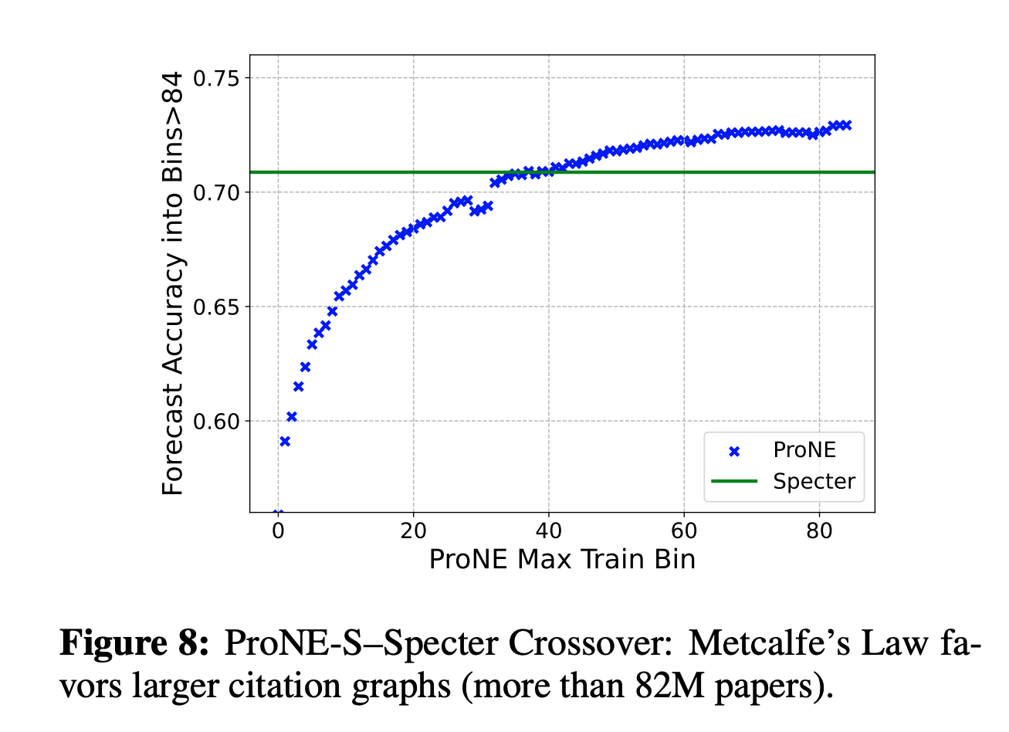
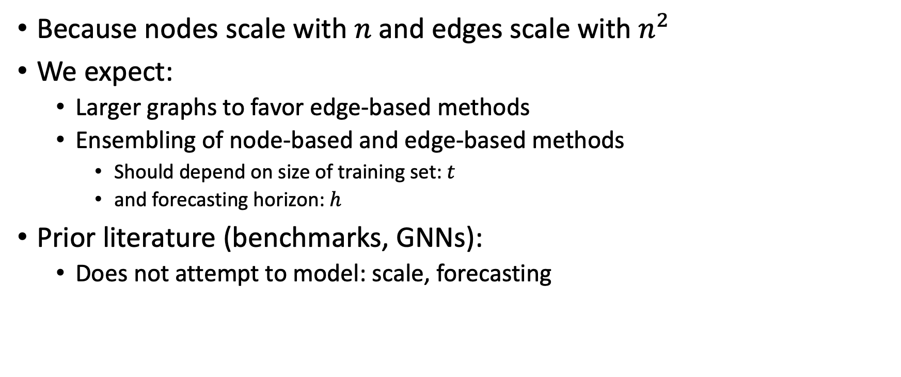
Network Effects: Conjectures
Because nodes scale with $n$and edges scale with $n^{2}$
We expect:
Larger graphs to favor edge-based methods
Ensembling of node-based and edge-based methods
Should depend on size of training set: $t$
and forecasting horizon: $h$
Prior literature (benchmarks, GNNs):
Does not attempt to model: scale, forecasting

Slide 3
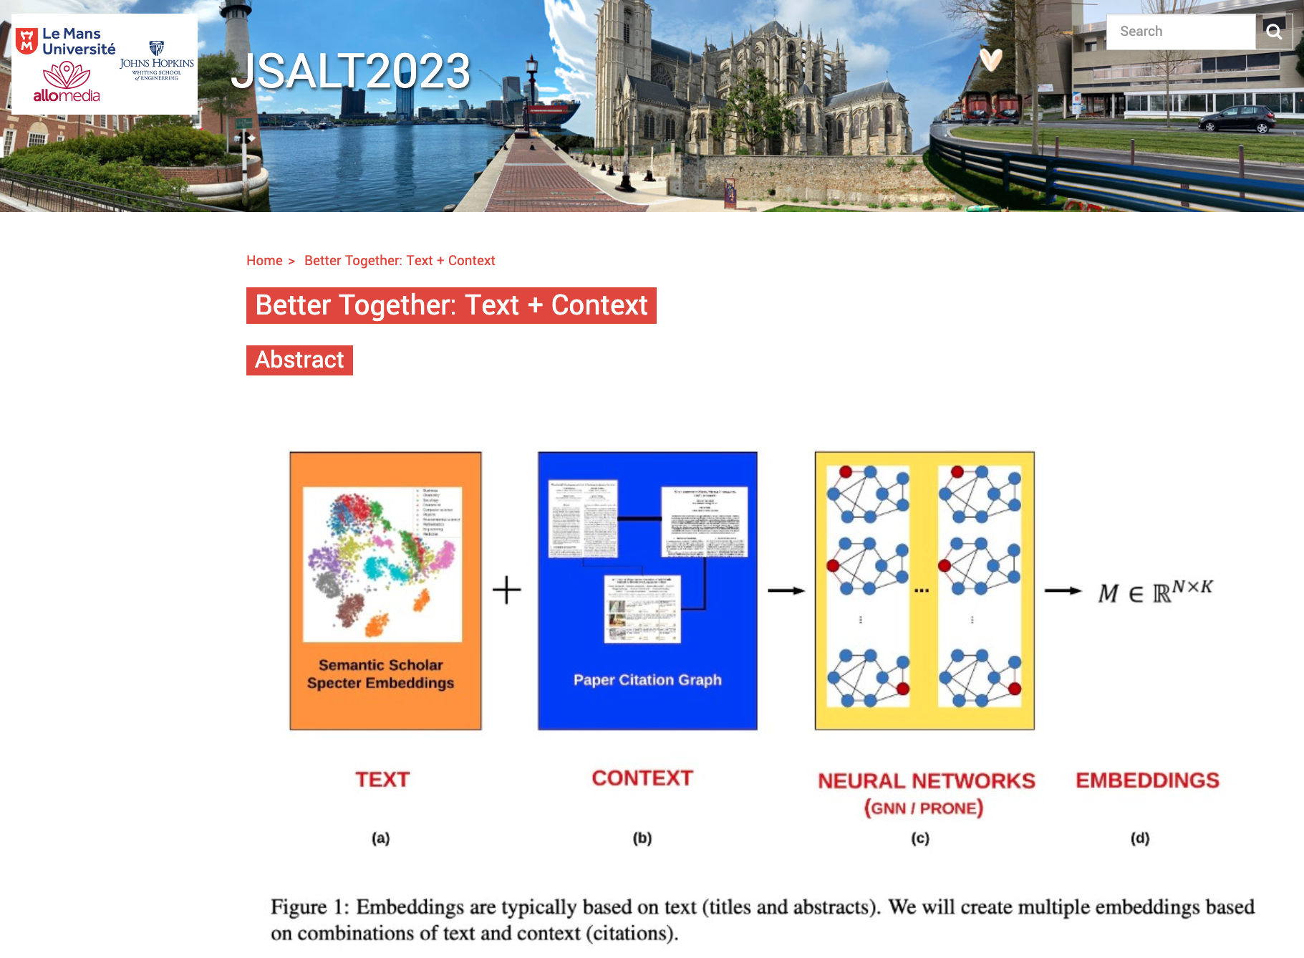
JSALT is a go! 2023 Jelinek Summer Workshop on Speech and Language Technology https://www.clsp.jhu.edu/2023-jelinek-summer-workshop/
Six weeks in France
Collaboration
Northeastern
Allen AI (Semantic Scholar)
UMass Amherst
Four Teams
Better together: Text + context
Ken Church (Northeastern)
Finite state methods with modern neural Architectures for speech applications and beyond
Mike Riley (Google)
Automatic design of conversational models from observation of human-to-human conversation
Interpretability for spoken interactions: how can we use embeddings to explain diarization decisions?

Slide 4
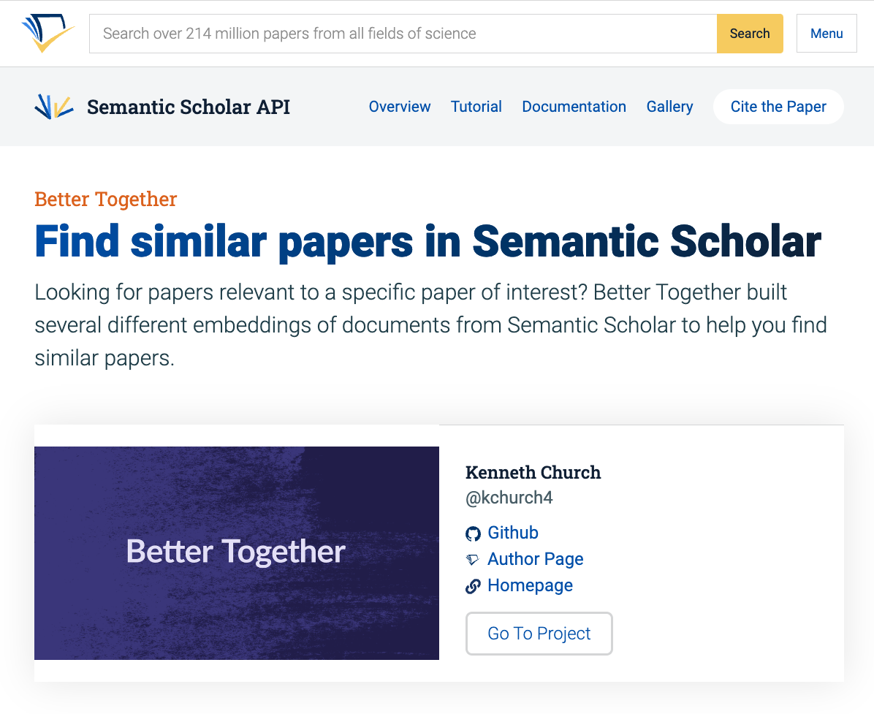
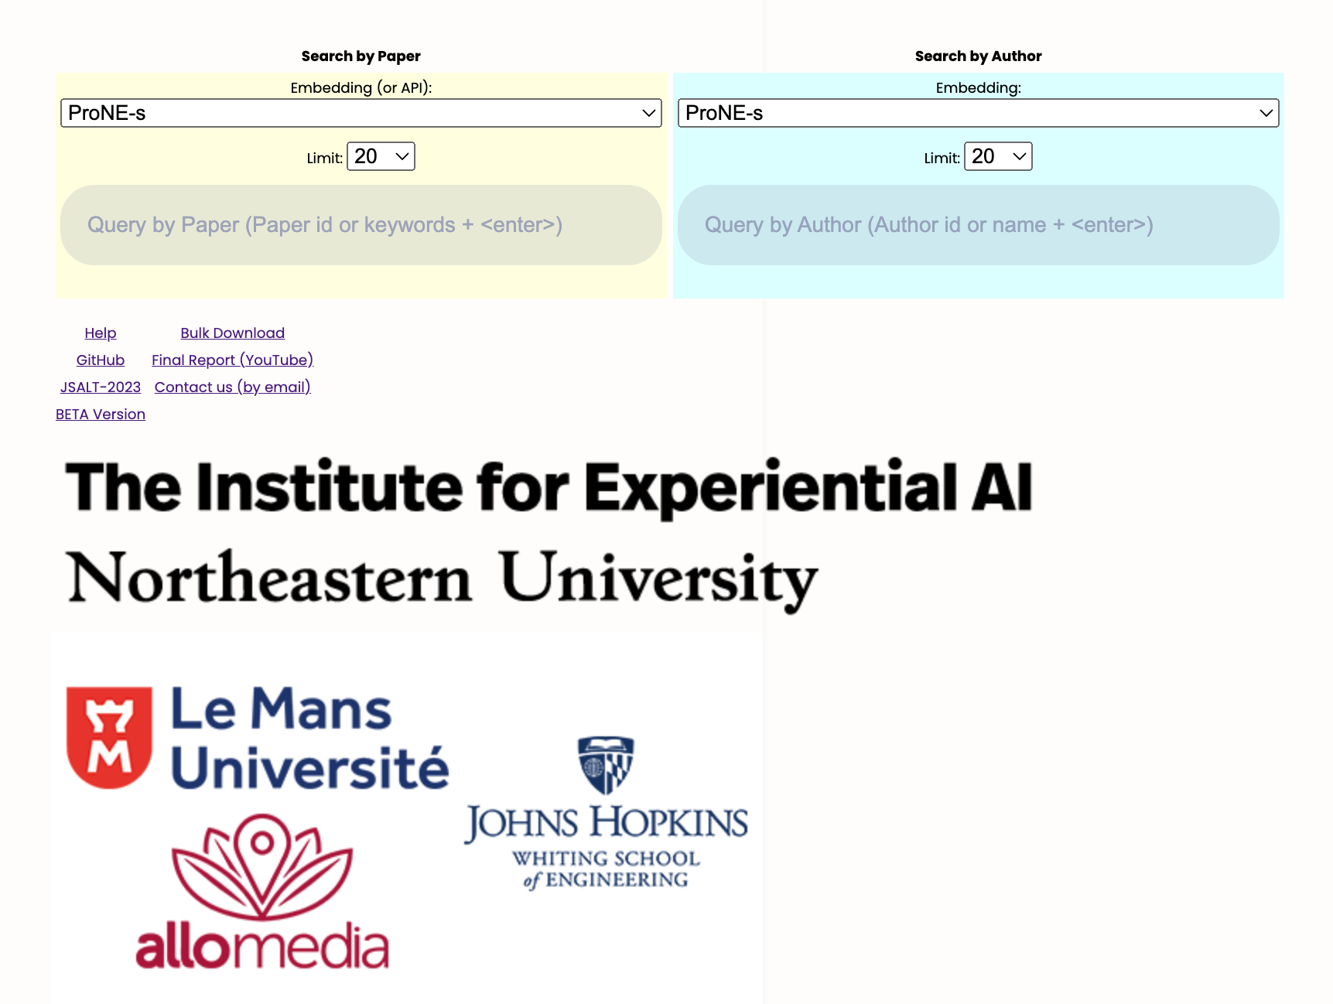

https://www.semanticscholar.org/api-gallery/better-together

Slide 5
Better Together
Point:
Encourage users to experiment
with different embeddings and recommendation APIs,
and learn what is good for what.
There are many academic search engines
based on a single embedding/API,
but we believe some embeddings/APIs are better in some cases,
and others are better in other cases.

Slide 6
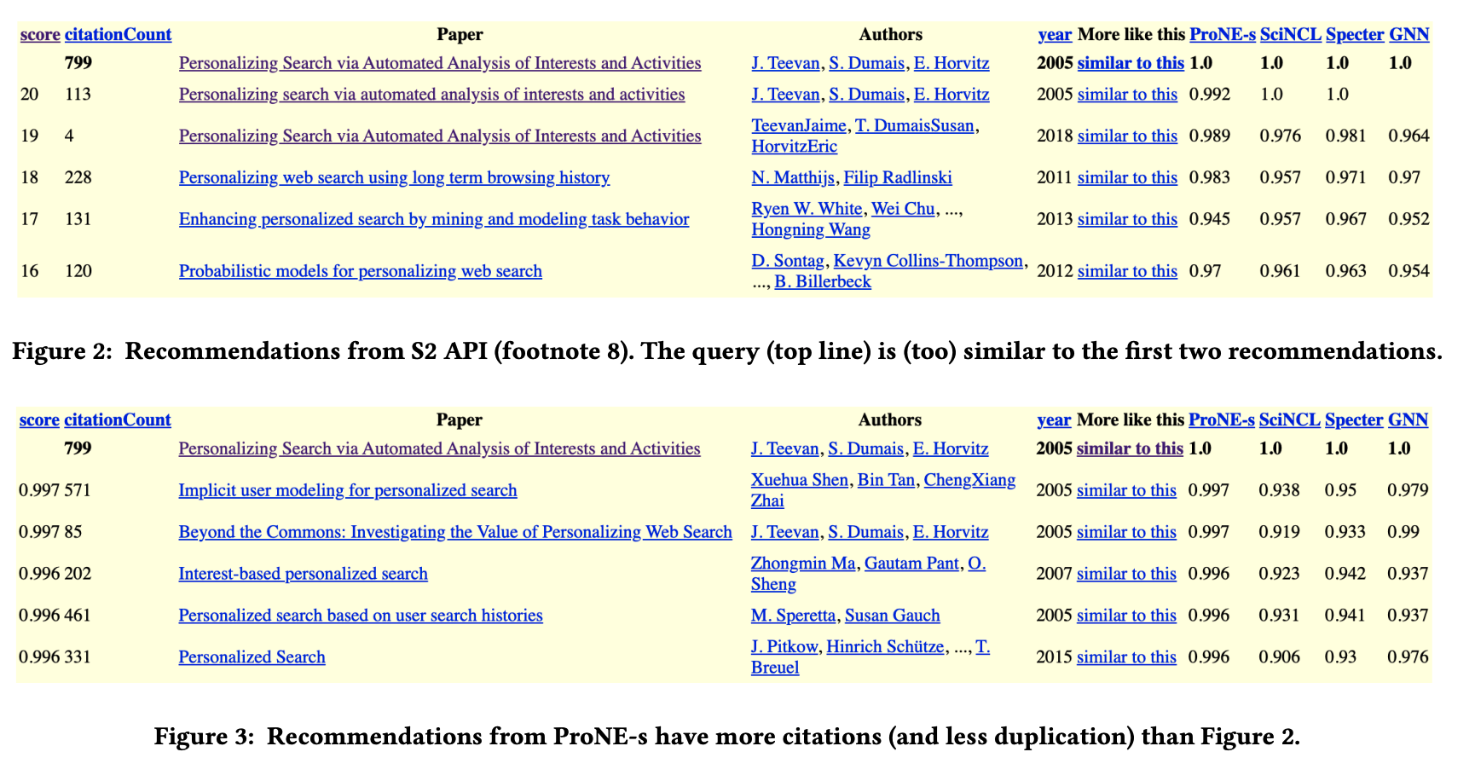

Slide 7
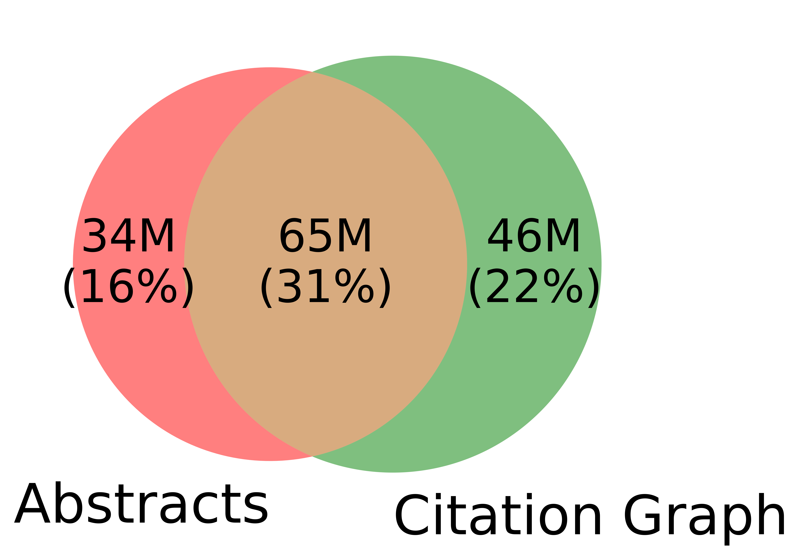
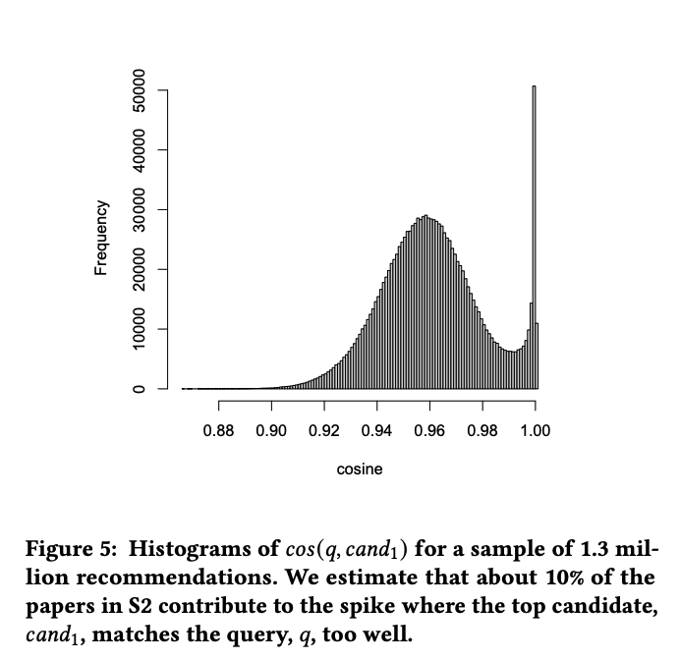
Corner Cases
Other
31%
Challenges for text-based methods
Duplicates
Missing/Bad Values
Non-English
Citation-based methods do not run into these corner cases, but
Missing/Bad Values

Slide 8
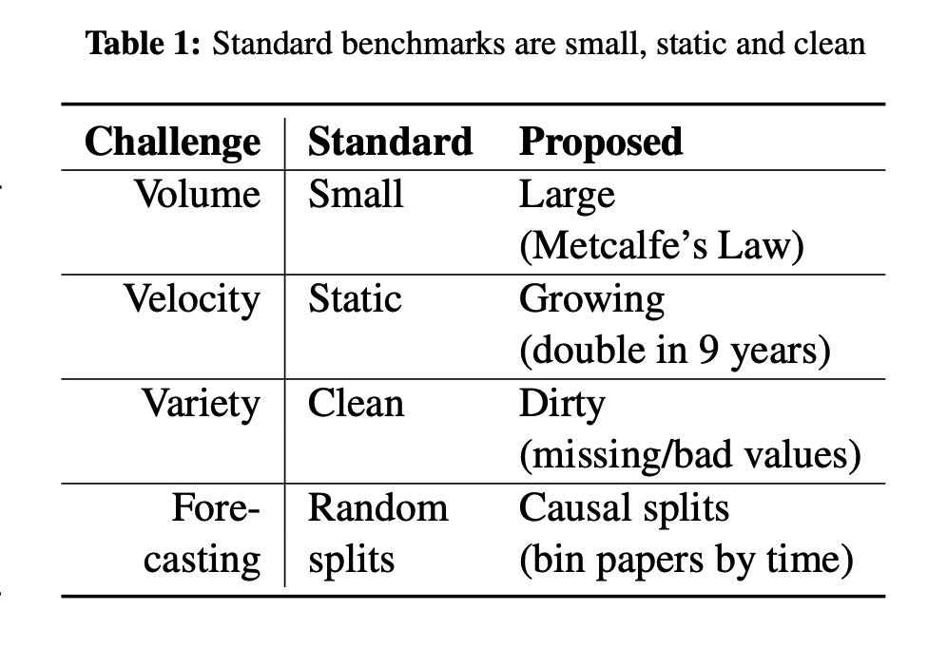

Slide 9
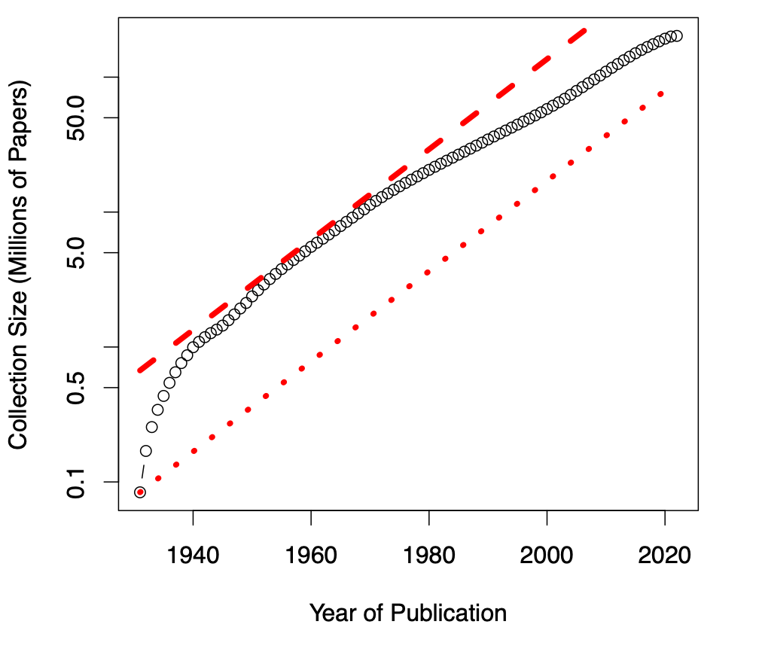
Growing: Literature Doubles Every Nine Years (90% was written after I started grad school)

Slide 10
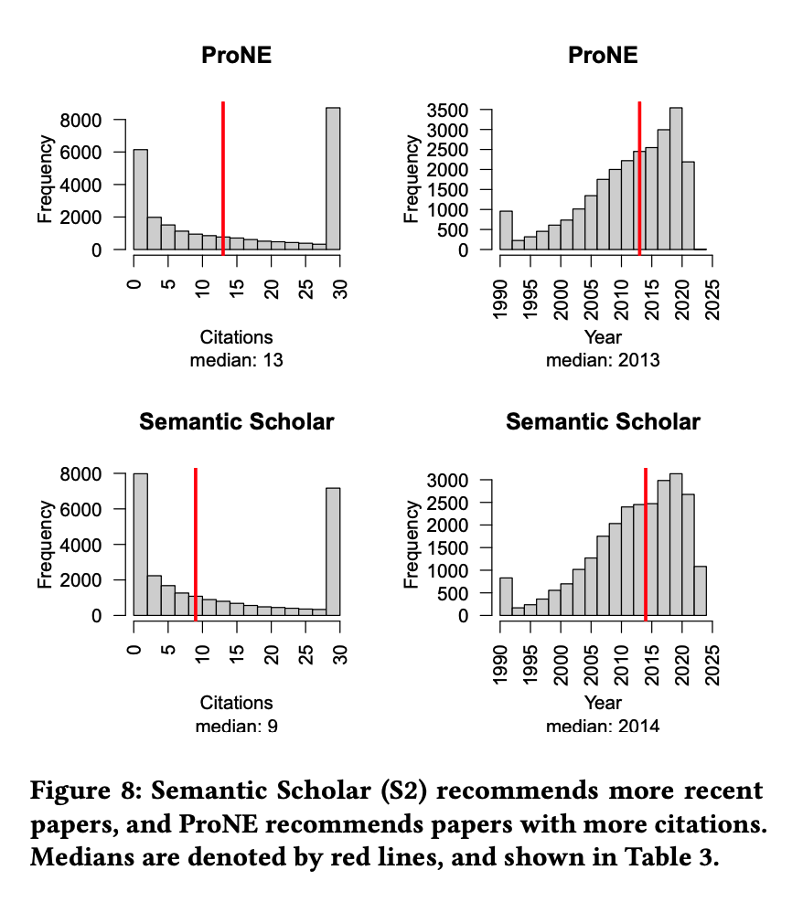
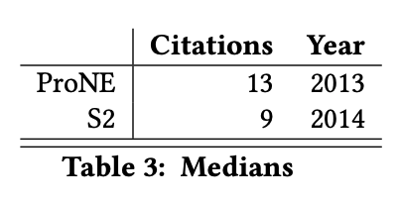
Evaluation: Better Together
Evaluation sections usually show proposed method is better than alternatives,
but we want to show methods
complement one another
Users are encouraged
to explore options
to find methods
that work well for their use case.

Slide 11
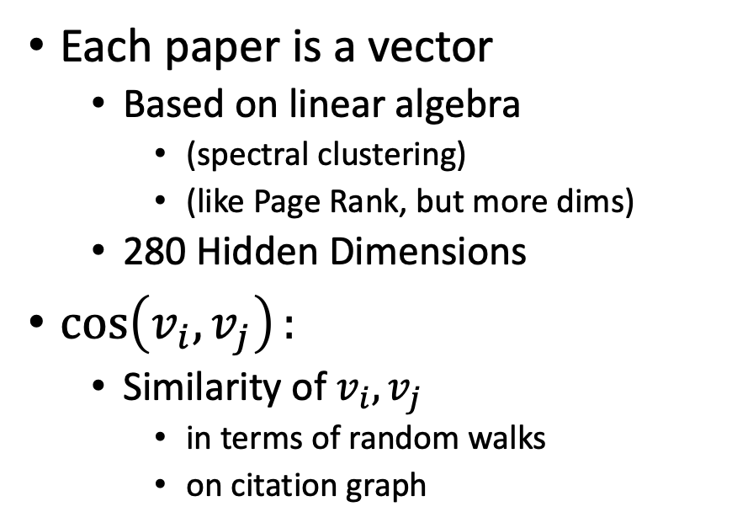
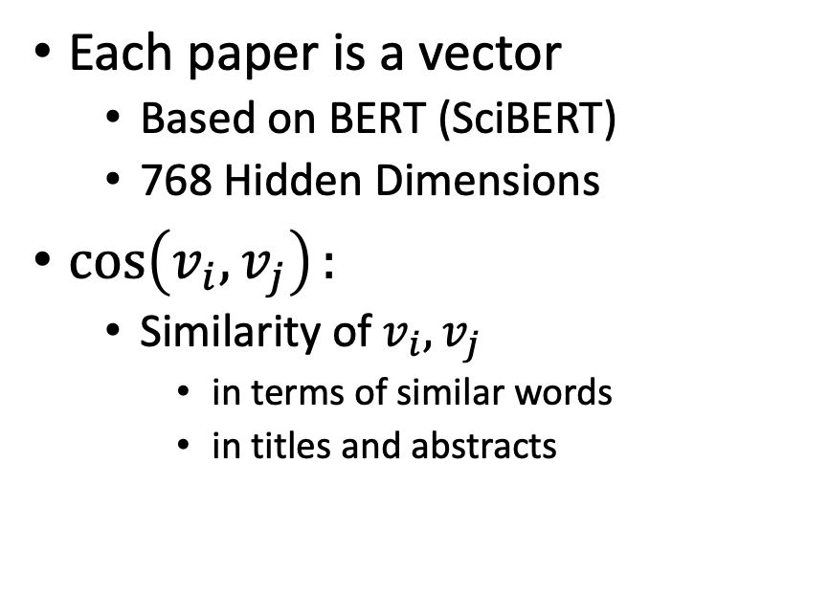
Better Together: Text (Abstracts) + Context (Citations)
Specter Embeddings (Text)
ProNE-s Embeddings (Citations)
Each paper is a vector
Based on BERT (SciBERT)
768 Hidden Dimensions
$\cos\left(v_{i},v_{j}\right):$
Similarity of $v_{i},v_{j}$
in terms of similar words
in titles and abstracts
Each paper is a vector
Based on linear algebra
(spectral clustering)
(like Page Rank, but more dims)
280 Hidden Dimensions
$\cos\left(v_{i},v_{j}\right):$
Similarity of $v_{i},v_{j}$
in terms of random walks
on citation graph

Slide 12
Example: Recommendations and Compare/Contrast

Slide 13
Recommendation Use Cases
For readers:
What should I read?
For authors:
What should I cite?
For conference organizers:
Who should review what?
Finding experts:
Who knows? (Streeter & Lochbaum, 1998)

Slide 14

Semantic Scholar API
https://api.semanticscholar.org/recommendations/v1/papers/forpaper/21321bad706a9f9dbb502588b0bb393cf15fa052?from=all-cs&fields=title,externalIds,citationCount
Semantic Scholar: A collection of 200M papers
query: 21321bad706a9f9dbb502588b0bb393cf15fa052
A paper id on Semantic Scholar
200M papers → Specter embeddings
BERT-like vectors with 768 hidden dimensions
Mostly encodes titles and abstracts (with some fine-tuning on citation graph)
from=all-cs: limits search to computer science
about 10% of their collection of 200M papers
uses FAISS to find approximate nearest neighbors for query

Slide 15
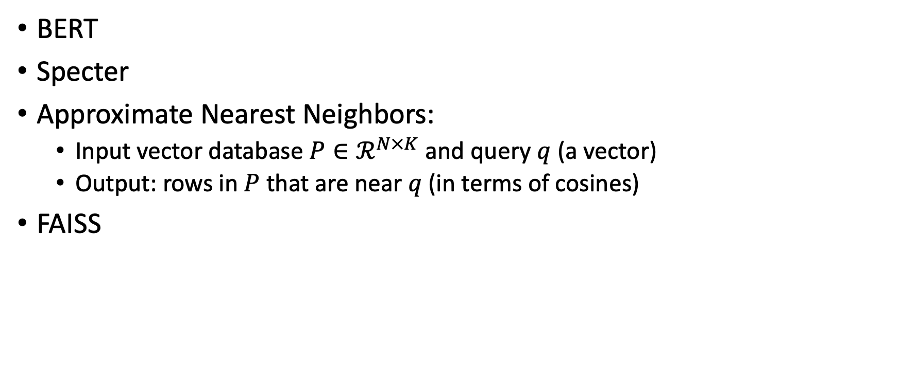
Need to explain these topics before getting into this example
BERT
Specter
Approximate Nearest Neighbors:
Input vector database $P∈ℛ^{N×K}$ and query $q$ (a vector)
Output: rows in $P$ that are near $q$ (in terms of cosines)
FAISS

Slide 16

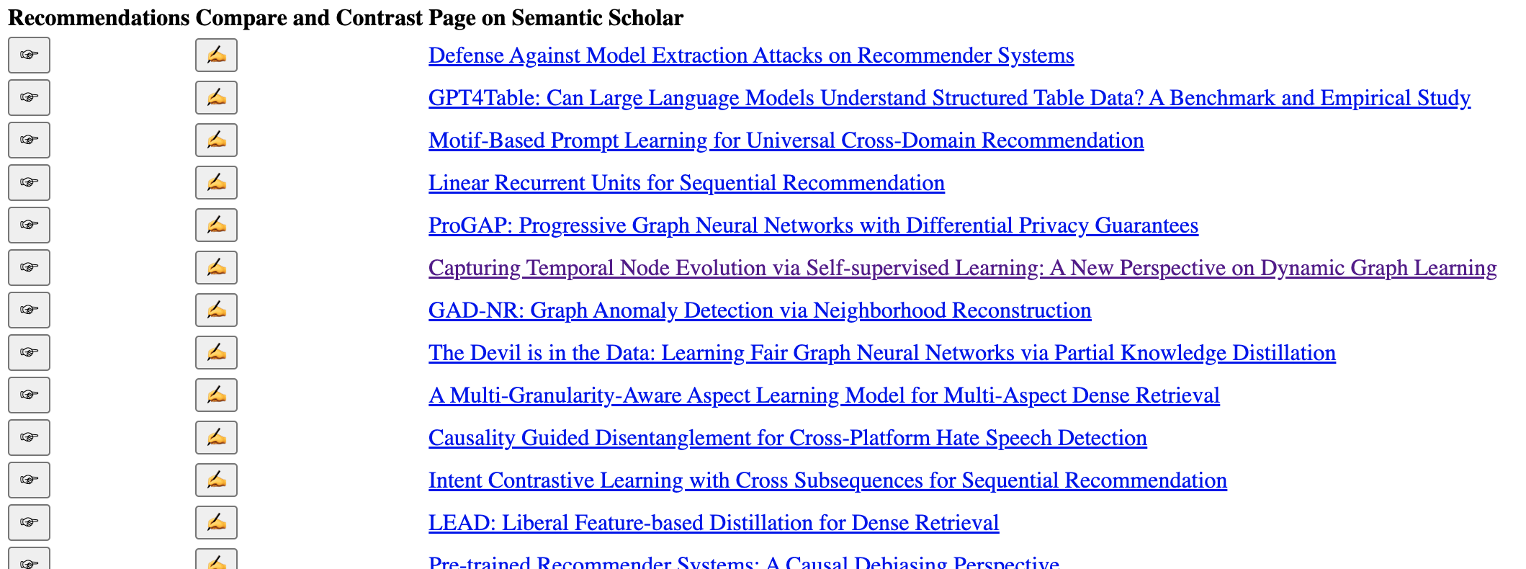
WSDM-2024 Papers on arXiv

Slide 17

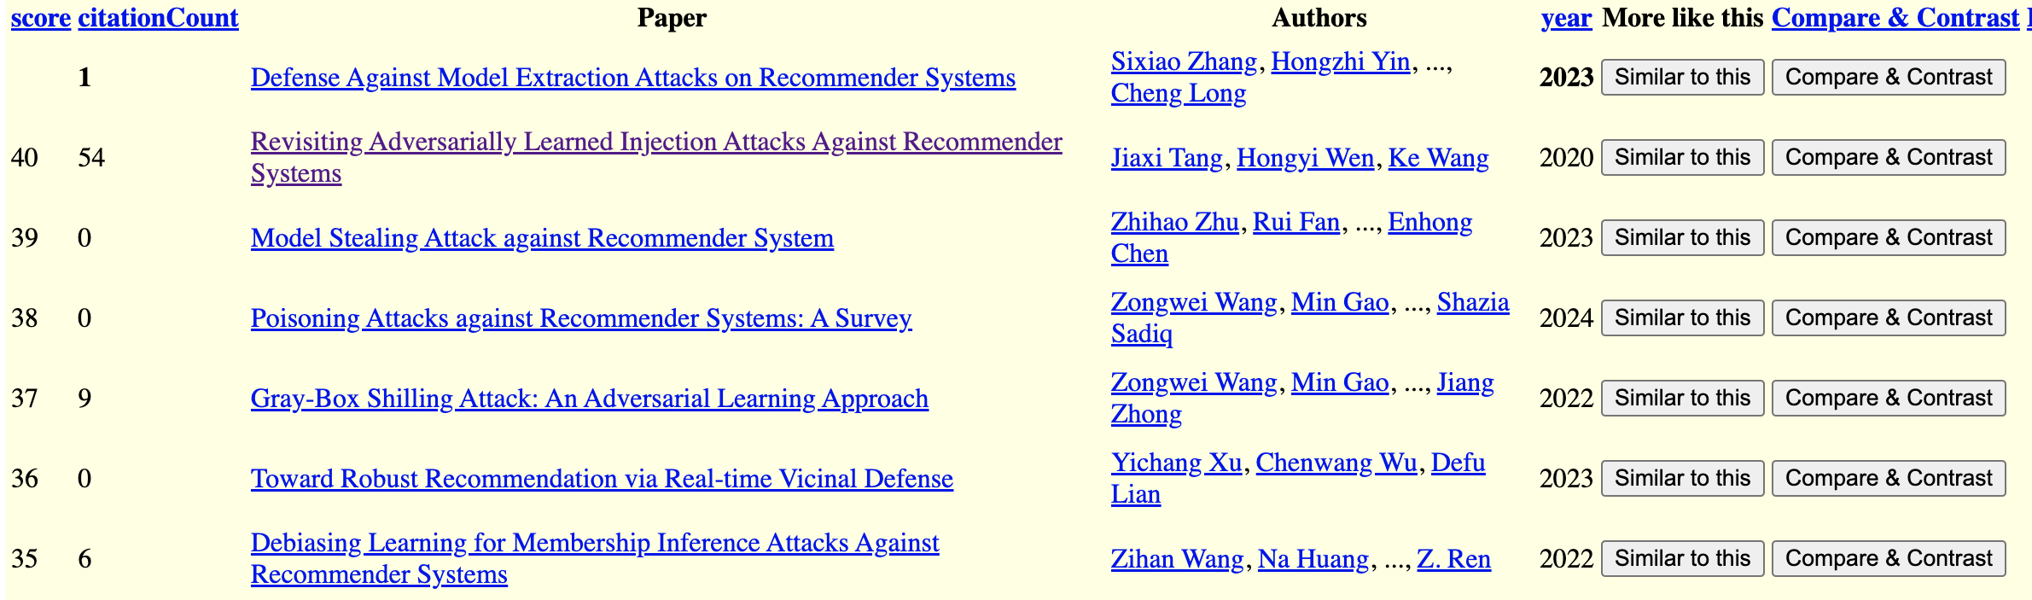
Recommendations for a Paper in WSDM-2024

Slide 18

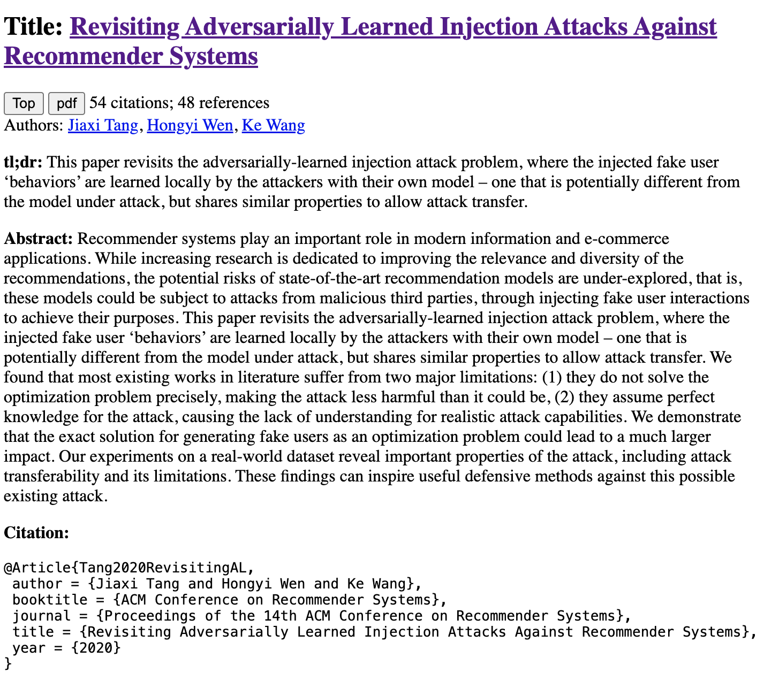
Compare and Contrast
Input: query + candidate
Use prompts (chatbots)
Summary of candidate
Similarities of query & candidate
Differences of query & candidate

Slide 19
Output from Chatbot
Similarities
Differences
As an Assistant, I can tell you that both "Revisiting Adversarially Learned Injection Attacks Against Recommender Systems" and "Defense Against Model Extraction Attacks on Recommender Systems" focus on security aspects of recommender systems.
The first paper explores injection attacks where the attacker manipulates the recommendation model by injecting malicious data,
while the second paper deals with defending against model extraction attacks aimed at extracting sensitive information from the recommender system.
Both papers highlight the importance of addressing security vulnerabilities in recommender systems to protect user data and maintain the integrity of the recommendation models.
"Revisiting Adversarially Learned Injection Attacks Against Recommender Systems" focuses on exploring adversarially learned injection attacks against recommender systems,
where the attacker has knowledge about the dataset used to train the target recommendation model.
On the other hand, "Defense Against Model Extraction Attacks on Recommender Systems" focuses on strategies to defend against model extraction attacks,
where attackers try to extract the architecture or parameters of a recommender system.
The former paper deals with adversarial attacks, while the latter focuses on defense mechanisms against a different type of attack.

Slide 20
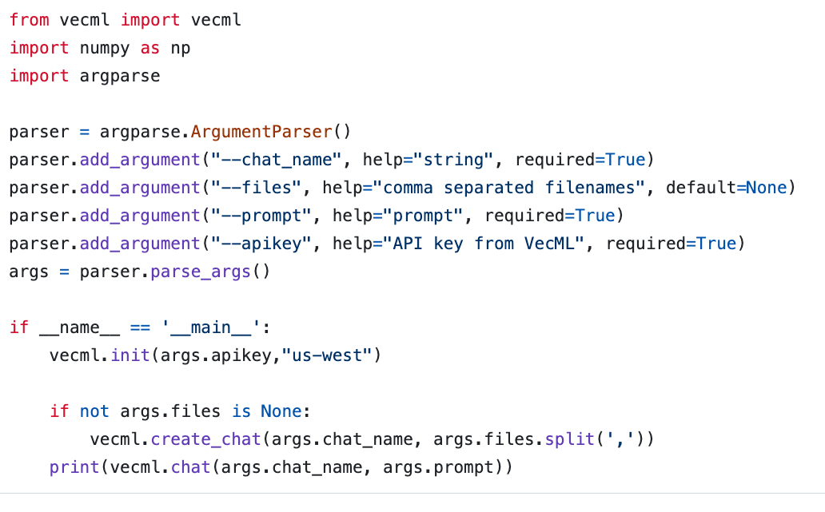
Chatbots are Super-Easy www.vecml.com

Slide 21
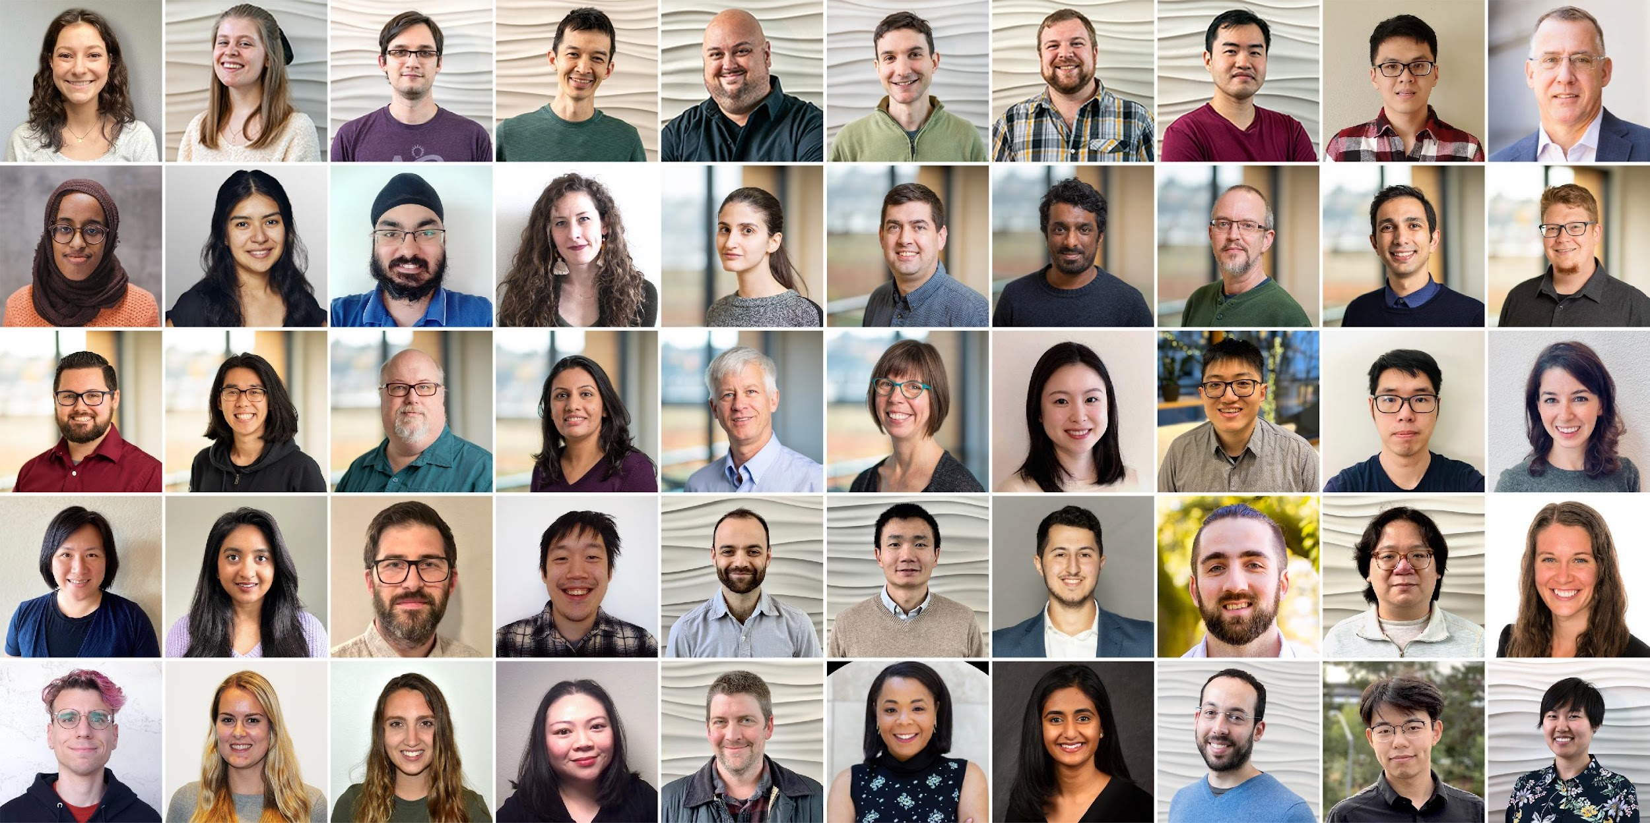
Semantic Scholar: Significant Effort (source: Dan Weld)
SCALE | SCALE
 | Source | Papers (millions)
1 | CorpusId | 207.80
2 | MAG (Microsoft Academic Graph) | 182.18
3 | DOI | 113.54
4 | PubMed | 35.03
5 | DBLP | 6.06
6 | PubMedCentral | 4.86
7 | ArXiv | 2.15
8 | ACL | 0.08
50 person team; 7 year project
207M+ papers; 2B Citations
8M+ monthly active users

Slide 22
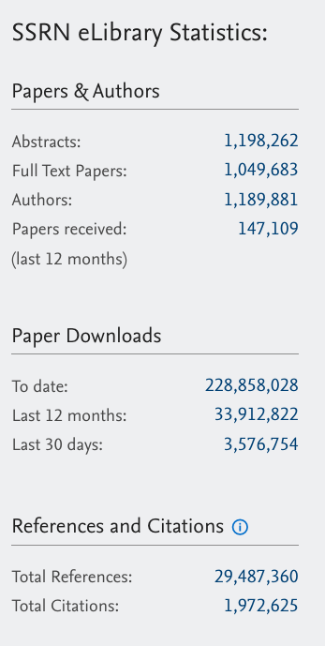
Diversity of Fields of Study Weak on Law, Journalism, etc.
Papers (millions) | Field of Study | Papers (millions) | Field of Study
45.2 | Medicine | 3.7 | Business
12.9 | Chemistry | 3.4 | Sociology
12.9 | Computer_Science | 3.0 | Geography
12.7 | Biology | 2.7 | Economics
10.0 | Materials_Science | 2.7 | Environmental_Science
8.2 | Engineering | 2.6 | Geology
6.8 | Physics | 2.1 | History
6.7 | Psychology | 1.8 | Art
5.3 | Mathematics | 1.1 | Philosophy
4.0 | Political_Science

Slide 23
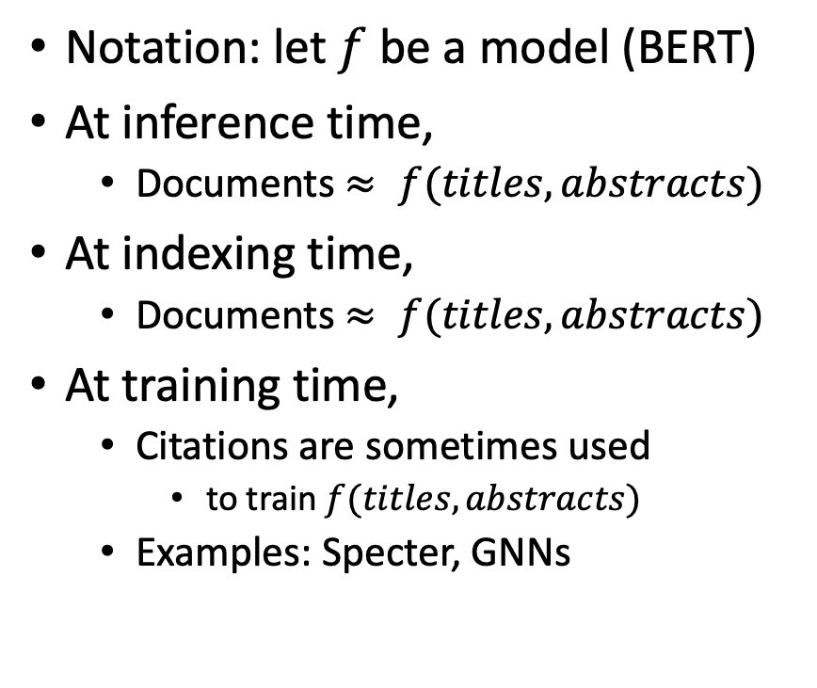
Current Practice: Title and Abstracts (and little else)
Notation: let $f$ be a model (BERT)
At inference time,
Documents $≈ f(titles, abstracts)$
At indexing time,
Documents $≈ f(titles, abstracts)$
At training time,
Citations are sometimes used
to train $f(titles, abstracts)$
Examples: Specter, GNNs
Opportunity:
Take advantage of citation graph
(and citing sentences)
at all times (inference, indexing, …)
What are citing sentences?
Like Anchor Text in Web Search
Citing sentences are sentences
in other docs
that cite doc of interest
Examples of usefulness:
Turing (1936)

Slide 24
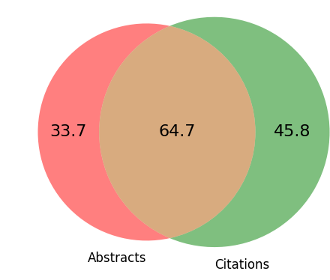
Opportunity: Many paper ids have abstracts or citations (but not both)
There are more papers
with citations (but not abstracts) [45.8M]
than vice versa [33.7M]
Example: highly cited book
Books do not have abstracts
(Most books are behind paywalls)
Better together opportunity
Text + Context (Citations)
Take advantage of what we have
Robust to missing values
Millions of Papers in Semantic Scholar
Millions of Papers in Semantic Scholar
Millions of Papers in Semantic Scholar
23%
45%
32%
Mentioned in Citation Graph
+63.6M Papers with neither

Slide 25
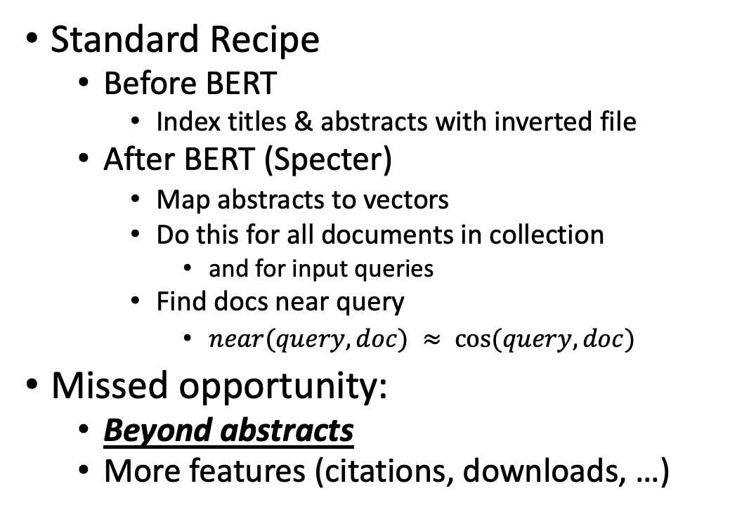
Motivation: Beyond Abstracts
Elastic Search
api.semanticscholar.org/recommendations
Recommendation Systems
What should I read?
What should I cite?
Assign submissions to reviewers
Find similar papers
Rank retrieval
Standard Recipe
Before BERT
Index titles & abstracts with inverted file
After BERT (Specter)
Map abstracts to vectors
Do this for all documents in collection
and for input queries
Find docs near query
$near(query, doc) ≈ cos⁡(query, doc)$
Missed opportunity:
Beyond abstracts
More features (citations, downloads, …)

Slide 26

Citation Graph: Clearly useful for some tasks
Recommendation Systems
What should I read?
What should I cite?
Assign submissions to reviewers
Find similar papers
Rank retrieval
Consider reviewer matching
When we started EMNLP
I would often assign submissions to tracks by hand (@ 2 min/paper)
I would skim title and abstract
and then flip to the references
Abstracts are hard to read
Formal language, long sentences
Often easier to match on refs
If a reviewer is cited, then they
know the background,
and agree with the approach
Often, Citations >> Abstracts
Poor matching → Iffy Reviewing → SOTA-Chasing

Slide 27
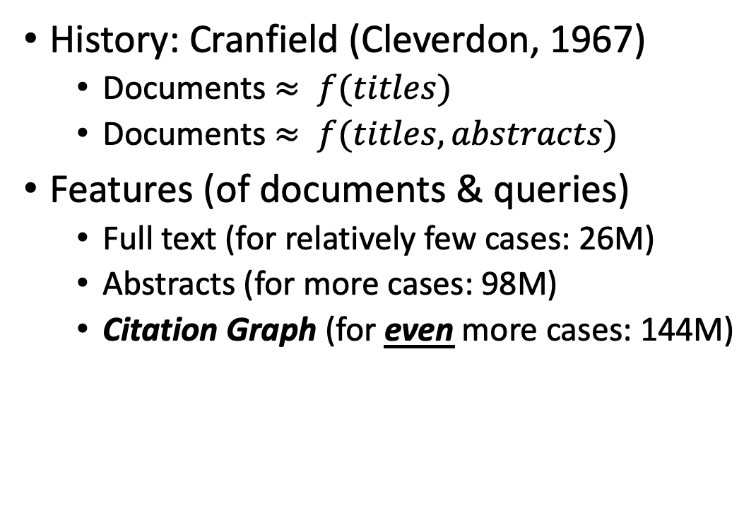
Much of the Literature on Academic Search is Based on Titles and Abstracts (and little else)
History: Cranfield (Cleverdon, 1967)
Documents $≈ f(titles)$
Documents $≈ f(titles, abstracts)$
Features (of documents & queries)
Full text (for relatively few cases: 26M)
Abstracts (for more cases: 98M)
Citation Graph (for even more cases: 144M)
N (millions of paper ids) | Case
207.8 | In Semantic Scholar
144.0 | With abstracts, citations and/or references
110.5 | With citations and/or references
98.4 | With abstracts
25.9 | With full text

Slide 28
Take advantage of what we have; Robust to missing values
Inference Tasks: Rank Retrieval / Recommender System
Inputs and outputs: lists of document ids
Input: query (1+ document ids)
Output: n-best list of nearby document ids
Features (properties of ids):
Text: Titles, Abstracts, Full Text
Links: Citation Graph, Citing Sentences
Challenge/Opportunity: Missing Values
Many systems focus on abstracts
(and fail when that is missing)
Many systems ignore links (at inference and indexing times)
and fail to take advantage of those opportunities

Slide 29
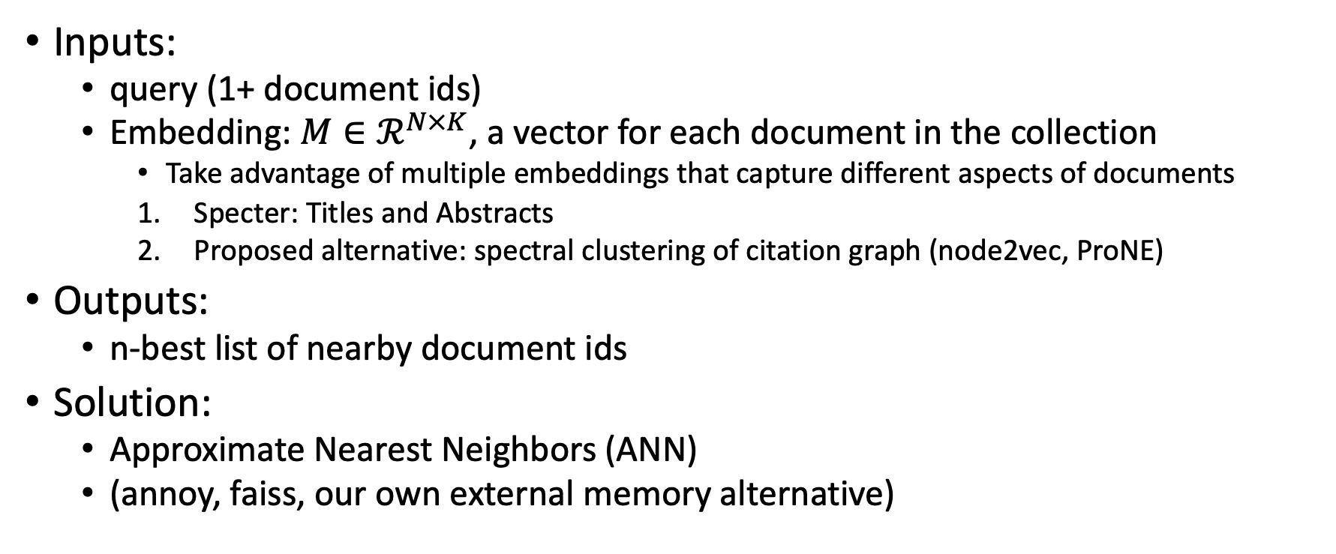
Proposed ANN Method
Inputs:
query (1+ document ids)
Embedding: $M∈ℛ^{N×K}$, a vector for each document in the collection
Take advantage of multiple embeddings that capture different aspects of documents
Specter: Titles and Abstracts
Proposed alternative: spectral clustering of citation graph (node2vec, ProNE)
Outputs:
n-best list of nearby document ids
Solution:
Approximate Nearest Neighbors (ANN)
(annoy, faiss, our own external memory alternative)

Slide 30
Rank | Specter | Proposed | Paper
query | 1.000 | 1.000 | 522: On the Dangers of Stochastic Parrots: Can Language Models Be Too Big? 🦜
1 | 0.794 | 0.957 | 3: What Language Model to Train if You Have One Million GPU Hours?
2 | 0.779 | 0.976 | 117: On the Stability of Fine-tuning BERT: Misconceptions, Explanations, and Strong Baselines
3 | 0.777 | 0.961 | 1: Emergent Properties of Finetuned Language Representation Models
4 | 0.774 | 0.792 | 0: Dim Wihl Gat Tun: The Case for Linguistic Expertise in NLP for Under-Documented Languages
5 | 0.763 | 0.244 | 8: Challenges in Machine Translation
6 | 0.755 | 0.333 | 1: Sequential Decisions and Predictions in Natural Language Processing
7 | 0.751 | 0.838 | 0: estion Answering over Curated and OpenWeb Sources
8 | 0.749 | 0.511 | 4: Recent Progress in Deep Learning for NLP
9 | 0.747 | 0.956 | 2: CTR-BERT: Cost-effective knowledge distillation for billion-parameter teacher models
1 | 0.615 | 0.992 | 139: RealToxicityPrompts: Evaluating Neural Toxic Degeneration in Language Models
2 | 0.750 | 0.992 | 49: The Radicalization Risks of GPT-3 and Advanced Neural Language Models
3 | 0.542 | 0.992 | 52: Persistent Anti-Muslim Bias in Large Language Models
4 | 0.695 | 0.990 | 29: Process for Adapting Language Models to Society (PALMS) with Values-Targeted Datasets
5 | 0.689 | 0.990 | 173: Are We Modeling the Task or the Annotator? An Investigation of Annotator Bias in Natural Language Understanding Datasets
6 | 0.287 | 0.989 | 11: Large language models associate Muslims with violence
7 | 0.676 | 0.989 | 53: Utility is in the Eye of the User: A Critique of NLP Leaderboards
8 | 0.618 | 0.988 | 20: Detoxifying Language Models Risks Marginalizing Minority Voices
9 | 0.703 | 0.988 | 315: Adversarial NLI: A New Benchmark for Natural Language Understanding
More cited and more critical

Slide 31
Task: Recommender System
Recommend papers that are both
Relevant to query, and
Credible (highly cited)

Slide 32


Rank | Specter | Proposed | Paper
query | 1.000 | 1.000 | 1097: On stress and linguistic rhythm
1 | 0.908 | 0.926 | 0: Linguistic Society of America Structure and Intonation
2 | 0.895 | 0.977 | 475: Preliminaries to linguistic phonetics
3 | 0.885 | 0.921 | 25: Linguistic Society of America On the Definition of Word by
4 | 0.881 | 0.763 | 37: On some defferences between Chinese and Japanese '-Wh'-elements
5 | 0.880 | 0.946 | 2: Some accentuation properties in Japanese and lexical phonology
6 | 0.865 | 0.824 | 6: Two Types of Zi-Verbs in Japanese
7 | 0.777 | 0.097 | 15: The Value of Natural Sounds
8 | 0.766 | 0.089 | 16: Re-Examining the Foundations
9 | 0.757 | 0.106 | 8: Facts and Faith in Biblical History
1 | 0.578 | 0.998 | 226: The phonology of rhythm in English
2 | 0.530 | 0.997 | 74: A grid-based theory of English meter
3 | -1.000 | 0.996 | 5: "What does Phonology tell us about Stress and Rhythm? Some Reflections on the Phonology of Stress"
4 | 0.460 | 0.994 | 1: Syllable structure and stress in Bahdinani Kurdish
5 | 0.442 | 0.994 | 35: Schwa in phonological theory
6 | -1.000 | 0.994 | 163: The Sound Pattern of Russian: A Linguistic and Acoustical Investigation
7 | 0.542 | 0.993 | 27: Empirical evidence for a deletion formulation of the rhythm rule in English
8 | 0.552 | 0.993 | 95: Prosodic Structure Above the Word
9 | 0.334 | 0.993 | 0: Syllable Contraction in Cantonese A-not-A Constructions: An Optimality Account

Slide 33
Rank | Specter | Proposed | Paper
query | 1.000 | 1.000 | 2083: Theano: A Python framework for fast computation of mathematical expressions
1 | 0.724 | 0.450 | 1: A Flexible Research-Oriented Framework for Distributed Training of Deep Neural Networks
2 | 0.721 | 0.158 | 13: Tapkee: an efficient dimension reduction library
3 | 0.701 | 0.105 | 0: Shelang : An Implementation of Probabilistic Programming Language and its Applications
4 | 0.696 | 0.284 | 29: PiNN: A Python Library for Building Atomic Neural Networks of Molecules and Materials
5 | 0.696 | 0.105 | 0: GPU implementation of singular value decomposition for high rank tensors
6 | 0.690 | 0.050 | 0: Algebras of Algorithms, Parallel Computing, and Software Auto-Tuning
7 | 0.688 | 0.882 | 14: Keynote: The computer science behind the Microsoft Cognitive Toolkit: An open source large-scale deep learning toolkit for Windows and Linux
8 | 0.687 | 0.125 | 3: Multireduce and Multiscan on Modern GPUs
9 | 0.679 | 0.302 | 1: GPU Accelerated Indexing for High Order Tensors in Google Colab
1 | 0.787 | 0.962 | 830: Theano: A CPU and GPU Math Compiler in Python
2 | 0.624 | 0.953 | 1379: Theano: new features and speed improvements
3 | NA | 0.953 | 399: Lasagne: First release.
4 | 0.561 | 0.949 | 233: Equilibrated adaptive learning rates for non-convex optimization
5 | 0.616 | 0.947 | 231: RMSProp and equilibrated adaptive learning rates for non-convex optimization.
6 | 0.720 | 0.945 | 9157: TensorFlow: Large-Scale Machine Learning on Heterogeneous Distributed Systems
7 | 0.520 | 0.943 | 0: DEEP LEARNING FOR MUSICAL INSTRUMENT RECOGNITION
8 | 0.616 | 0.943 | 27771: Dropout: a simple way to prevent neural networks from overfitting
9 | 0.325 | 0.941 | 5804: Deep Sparse Rectifier Neural Networks

Slide 34
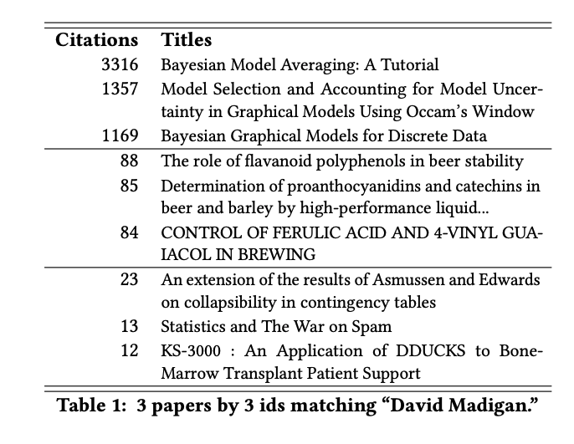
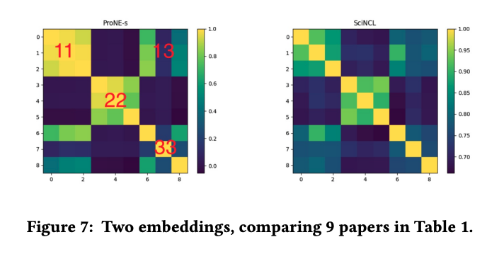
Who is Who?

Slide 35
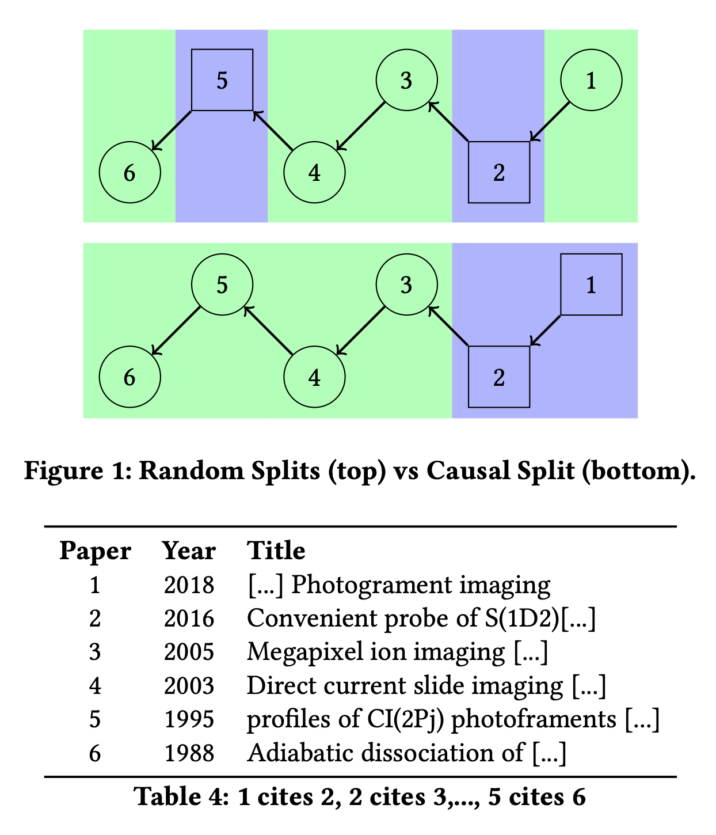
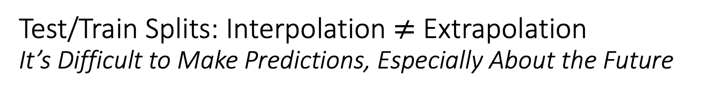
Test/Train Splits: Interpolation $≠$ Extrapolation It’s Difficult to Make Predictions, Especially About the Future
It is common for graphs to evolve over time.
For example, the academic literature is growing very quickly,
doubling every nine years
Benchmarks such as OGB focus on static snapshots from a few years ago,
missing opportunities to encourage the community to study growth and timeliness.
Random splits are common in graph learning benchmarks, e.g., WN18RR,
a popular Knowledge Graph Completion (KGC) task based on WordNet

Slide 36
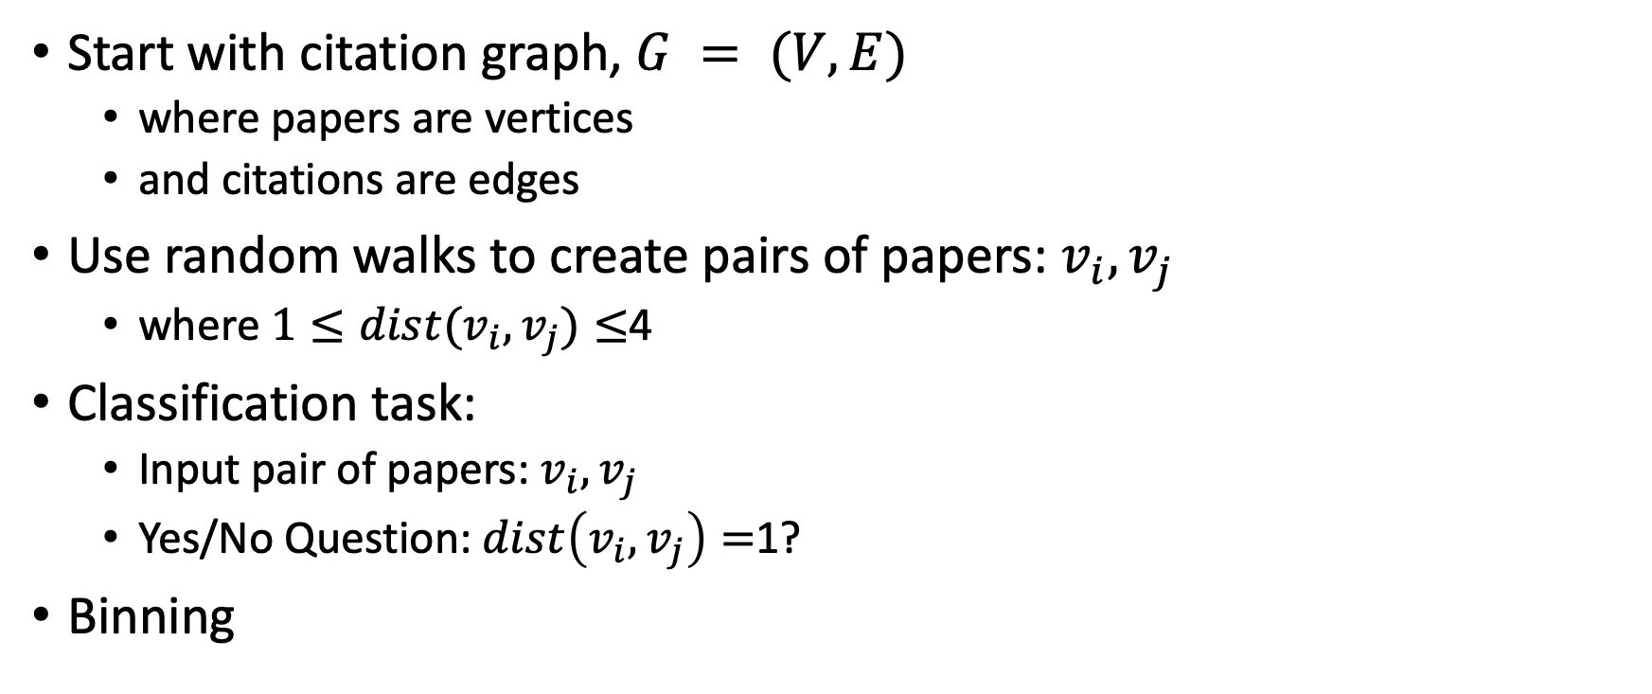
Link Prediction Task: Intrinsic Evaluation
Start with citation graph, $G = (V, E)$
where papers are vertices
and citations are edges
Use random walks to create pairs of papers: $v_{i},v_{j}$
where $1≤dist(v_{i},v_{j})≤$4
Classification task:
Input pair of papers: $v_{i},v_{j}$
Yes/No Question: $dist\left(v_{i},v_{j}\right)=$1?
Binning

Slide 37
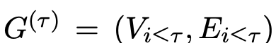
Binning It’s Difficult to Make Predictions, Especially About the Future
Split 200M papers into 100 bins
Rank papers by publication date
First 2M papers → bin0
Next 2M papers → bin1
Construct 100 graphs
that include papers (vertices) in the current bin or previous bins
and citations (edges) from these papers to papers in the current bin or previous bins
Construct 100 ProNE-s models,
One for each graph

Slide 38
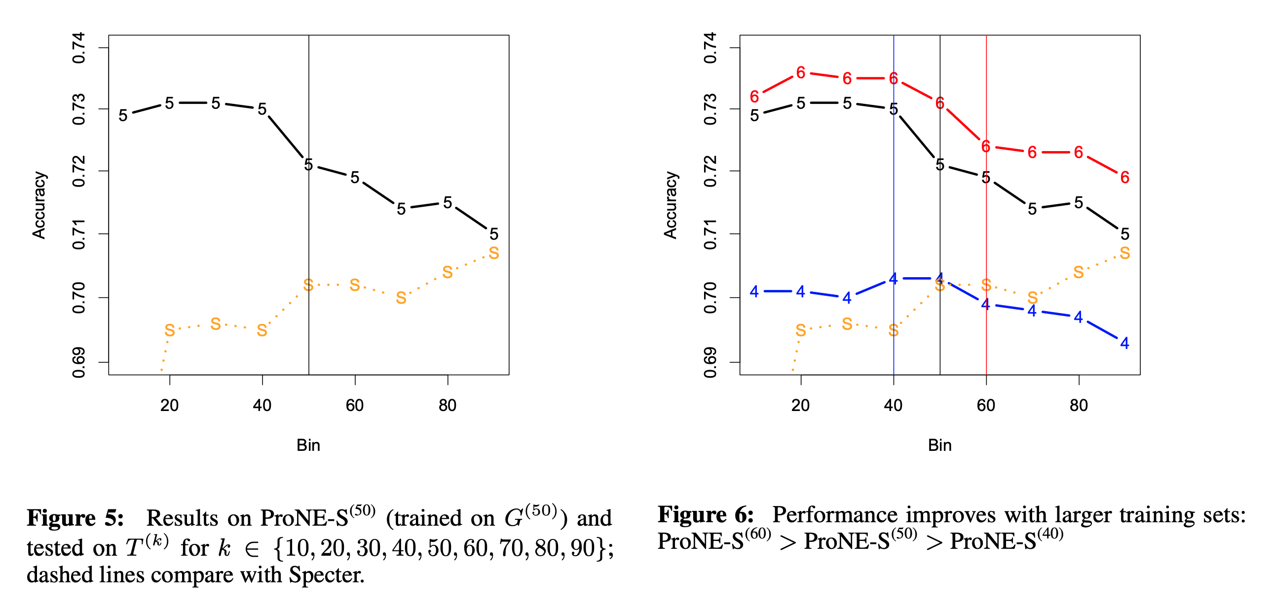

Slide 39
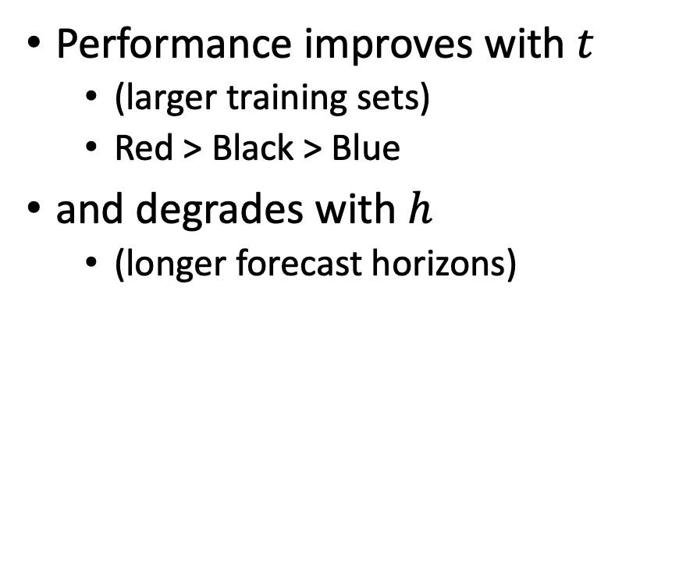
Take-Aways
Performance improves with $t$
(larger training sets)
Red > Black > Blue
and degrades with $h$
(longer forecast horizons)

Slide 40
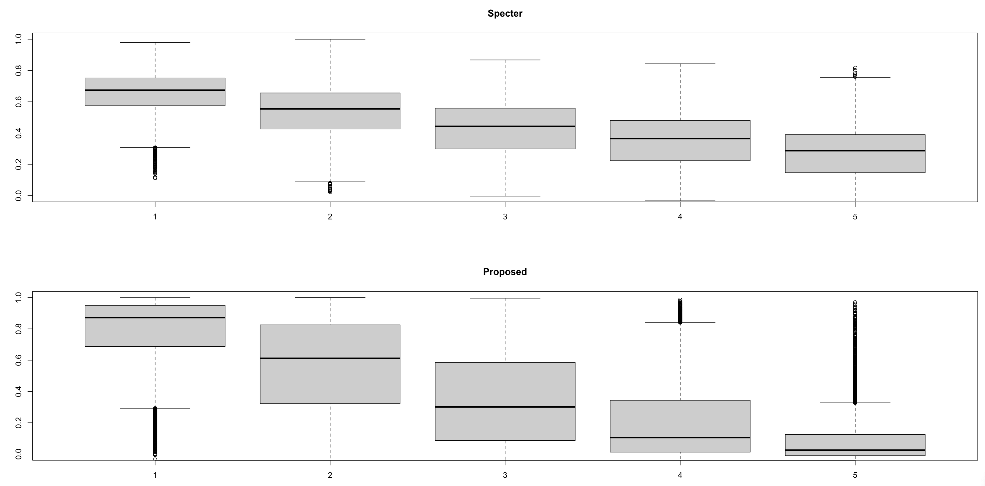

Slide 41
Spoiler Alert: Better-Together Conjectures
Multiple representations are helpful
for missing values (and bad values)
If abstracts are missing, use links
If links are missing, use abstracts
and for graphs of different sizes
When graphs are small (benchmarks):
Text >> Links
when graphs are large:
Links >> Text (Metcalfe’s Law)
Other
31%

Slide 42


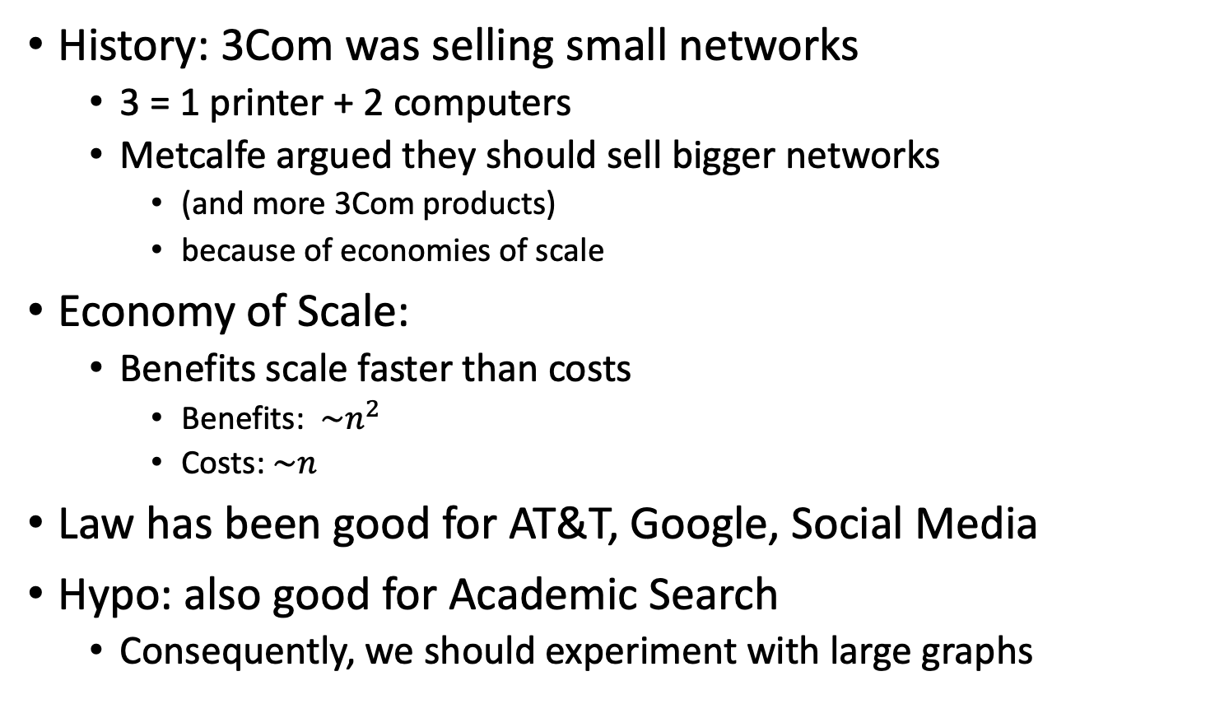
Metcalfe’s Law (Network Effects)
History: 3Com was selling small networks
3 = 1 printer + 2 computers
Metcalfe argued they should sell bigger networks
(and more 3Com products)
because of economies of scale
Economy of Scale:
Benefits scale faster than costs
Benefits: $\sim n^{2}$
Costs:$\sim n$
Law has been good for AT&T, Google, Social Media
Hypo: also good for Academic Search
Consequently, we should experiment with large graphs

Slide 43
Because edges grow faster than nodes
Hypothesis:
Larger graphs favor
citation-based methods
over text-based alternatives
Spoiler alert:
True, but for very large graphs
Larger than most benchmarks

Slide 45
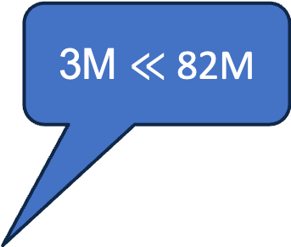
3M $≪$ 82M
Benchmark | #N | #E | Hidden Dimensions (node features)
ogbl-citation2 | 3M | 31M | 128 (eg. word2vec)
Semantic Scholar | 200M | 2B | 768 (eg. Bert)
Notes:
Graph showing growth

Slide 46
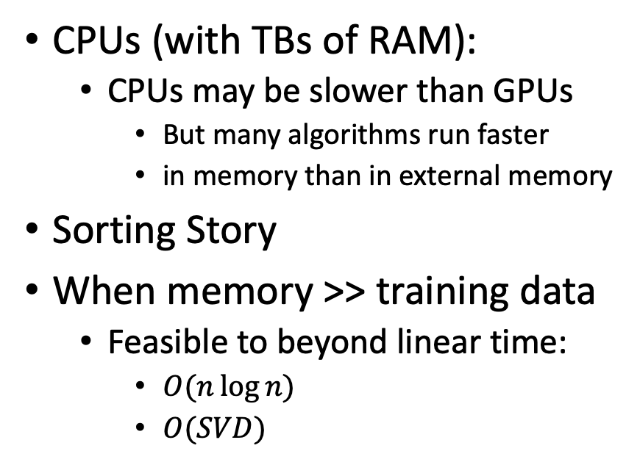
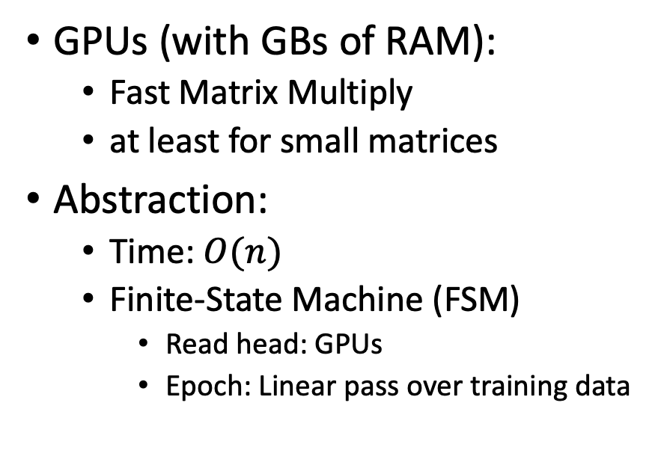
Computing Environments: GPUs (with GBs) vs. CPUs (with TBs) (People think about what they can afford to think about)
Deep Nets:
Pre-training, Fine-Tuning, GNNs
Linear Algebra:
SVD, ProNE
GPUs (with GBs of RAM):
Fast Matrix Multiply
at least for small matrices
Abstraction:
Time: $O(n)$
Finite-State Machine (FSM)
Read head: GPUs
Epoch: Linear pass over training data
CPUs (with TBs of RAM):
CPUs may be slower than GPUs
But many algorithms run faster
in memory than in external memory
Sorting Story
When memory >> training data
Feasible to beyond linear time:
$O(n\log{n})$
$O(SVD)$

Slide 47
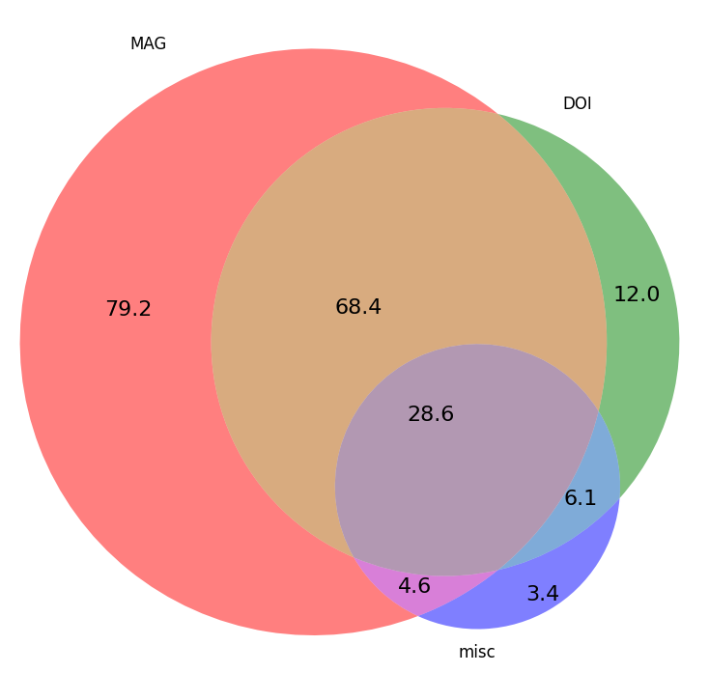
Scale: Blessing & Curse Citation Graphs → Network Effects
 | Source | Papers (millions)
1 | CorpusId | 207.80
2 | MAG (Microsoft Academic Graph) | 182.18
3 | DOI | 113.54
4 | PubMed | 35.03
5 | DBLP | 6.06
6 | PubMedCentral | 4.86
7 | ArXiv | 2.15
8 | ACL | 0.08

Slide 48
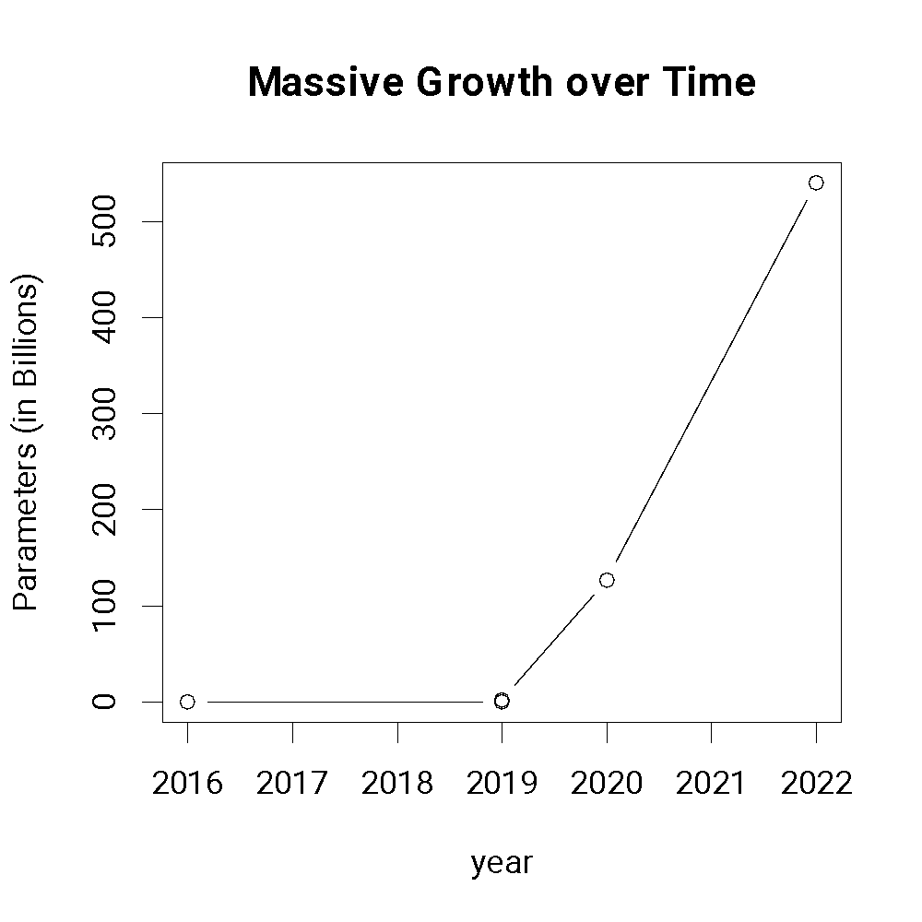
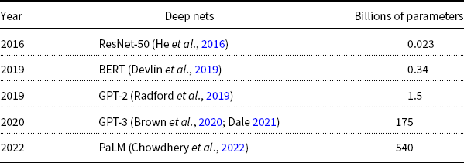
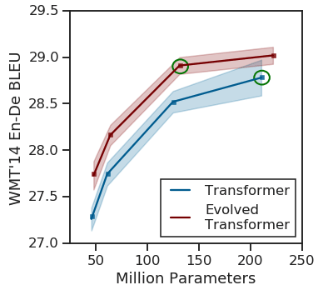
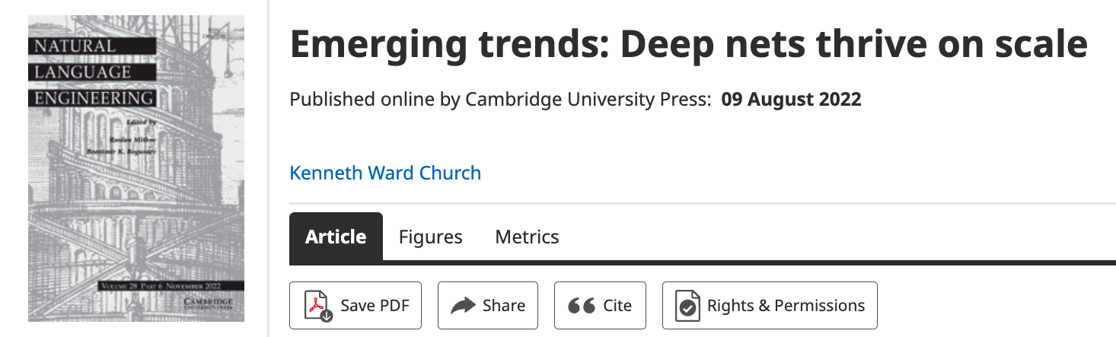
Bigger is Better! Why?

Slide 49
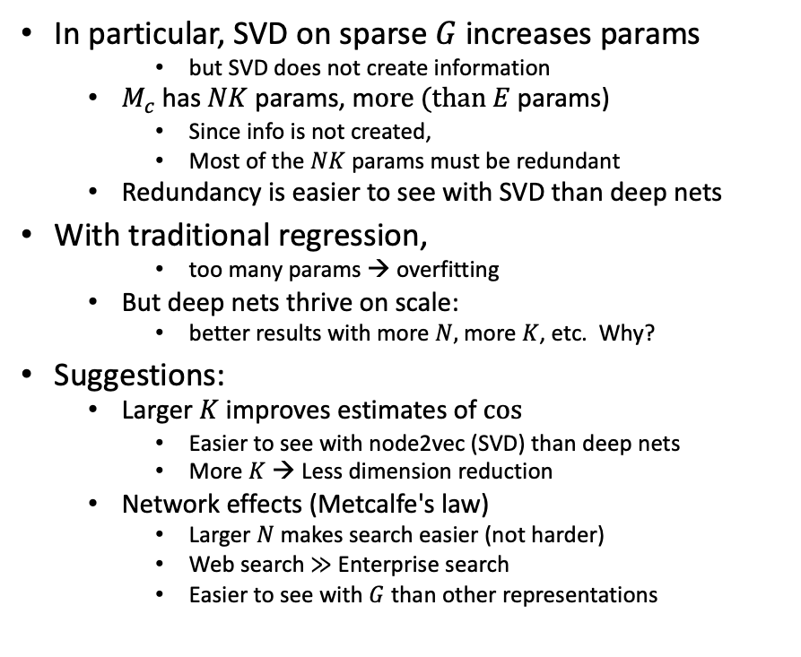
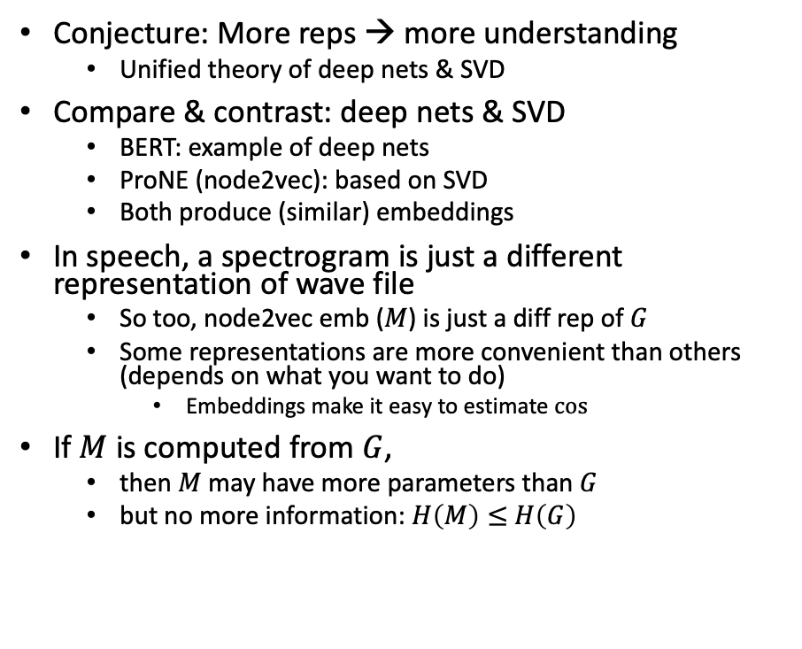
Bigger Stretch: Theoretical combinations of deep nets & SVD
Conjecture: More reps → more understanding
Unified theory of deep nets & SVD
Compare & contrast: deep nets & SVD
BERT: example of deep nets
ProNE (node2vec): based on SVD
Both produce (similar) embeddings
In speech, a spectrogram is just a different representation of wave file
So too, node2vec emb ($M$) is just a diff rep of $G$
Some representations are more convenient than others (depends on what you want to do)
Embeddings make it easy to estimate $cos⁡⁡$
If $M$ is computed from $G$,
then $M$ may have more parameters than $G$
but no more information: $H\left(M\right)≤$ $H\left(G\right)$
In particular, SVD on sparse $G$increases params
but SVD does not create information
$M_{c}$has $NK$ params, m$ore (than E$params)
Since info is not created,
Most of the $NK$ params must be redundant
Redundancy is easier to see with SVD than deep nets
With traditional regression,
too many params → overfitting
But deep nets thrive on scale:
better results with more $N,$ more $K$, etc. Why?
Suggestions:
Larger $K$ improves estimates of $cos⁡$
Easier to see with node2vec (SVD) than deep nets
More $K$ → Less dimension reduction
Network effects (Metcalfe's law)
Larger $N$ makes search easier (not harder)
Web search $≫$ Enterprise search
Easier to see with $G$ than other representations

Slide 50
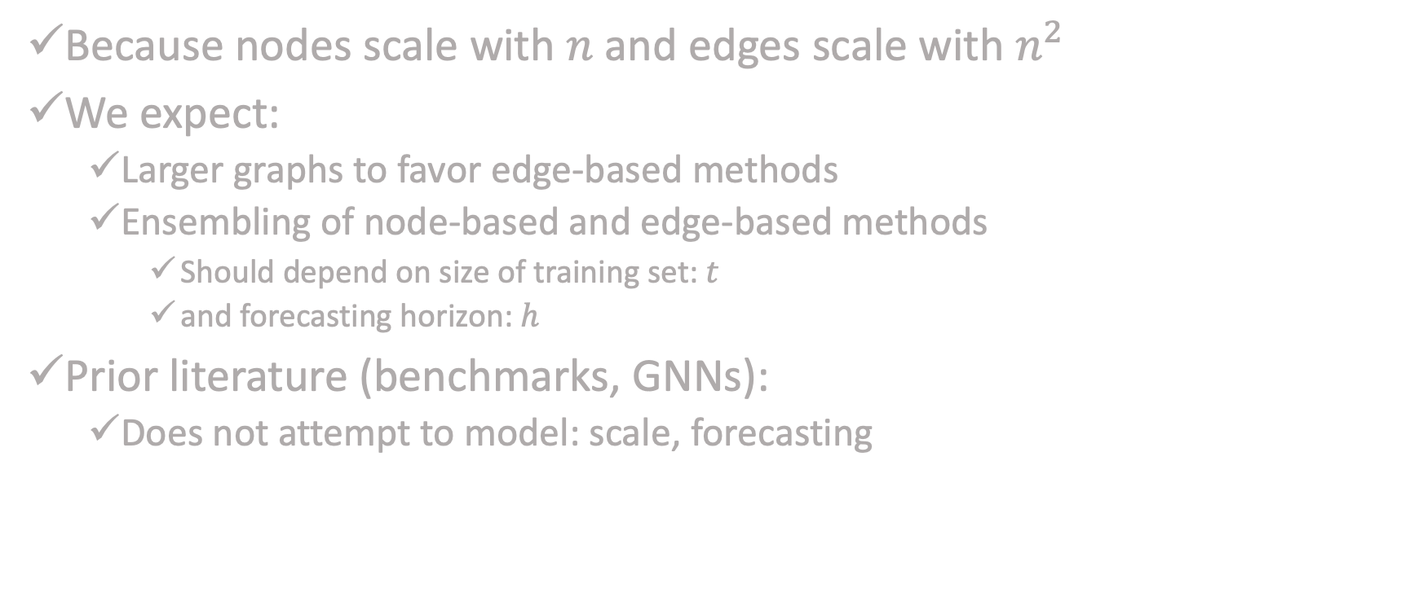
Network Effects: Conjectures
Because nodes scale with $n$and edges scale with $n^{2}$
We expect:
Larger graphs to favor edge-based methods
Ensembling of node-based and edge-based methods
Should depend on size of training set: $t$
and forecasting horizon: $h$
Prior literature (benchmarks, GNNs):
Does not attempt to model: scale, forecasting

Slide 51
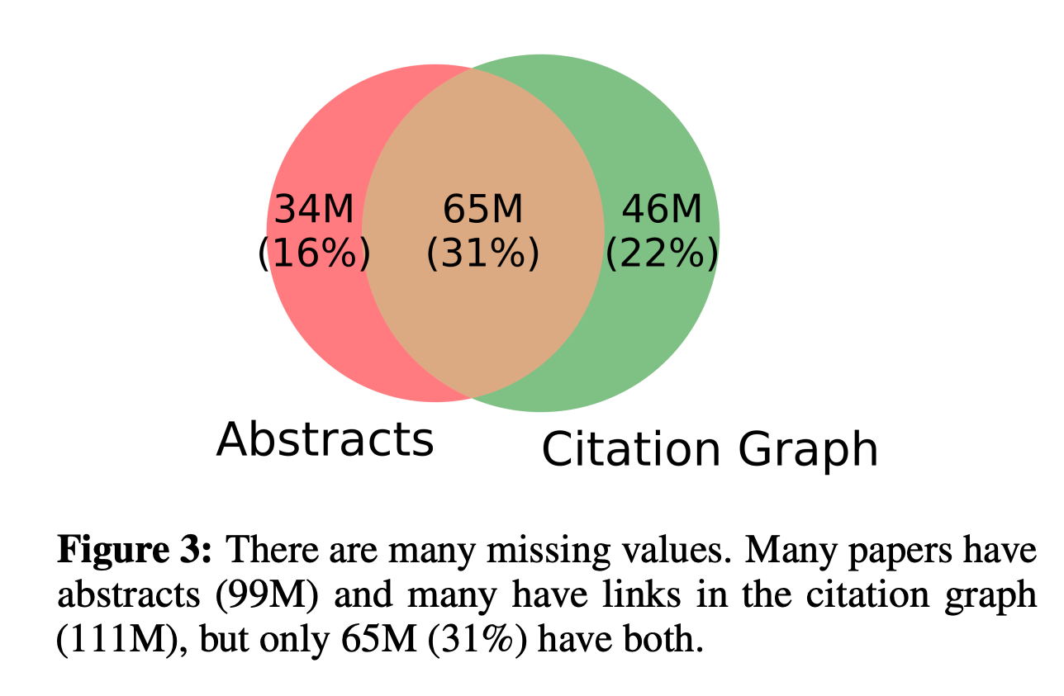
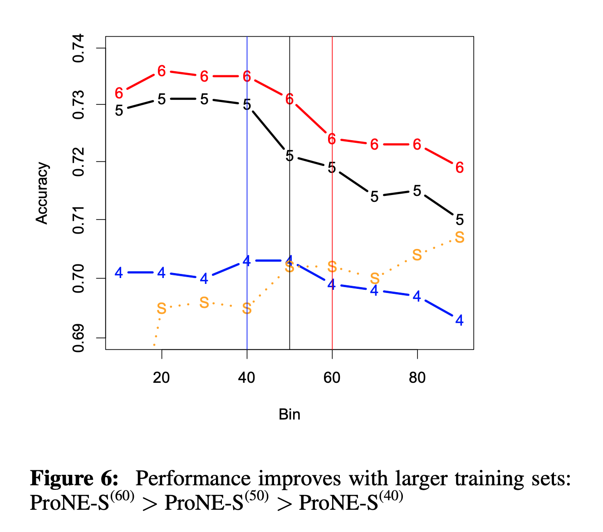
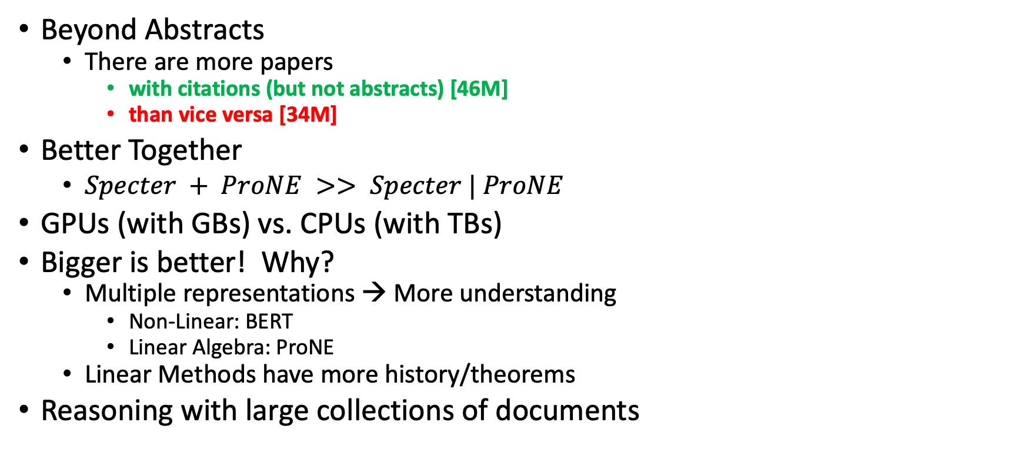
Conclusions
Beyond Abstracts
There are more papers
with citations (but not abstracts) [46M]
than vice versa [34M]
Better Together
$Specter + ProNE >> Specter | ProNE$
GPUs (with GBs) vs. CPUs (with TBs)
Bigger is better! Why?
Multiple representations → More understanding
Non-Linear: BERT
Linear Algebra: ProNE
Linear Methods have more history/theorems
Reasoning with large collections of documents

Slide 52
Challenge: Reasoning with Large Collections of Documents
Examples:
Documents that match query
Documents in field/subfield/topic/venue
Documents by certain authors
WHO: time/space/disease

Slide 53

WHO/ProMed Application (Is Freeware >> Legit/Official/$$$ ?)
WHO:
Mandate to issue alerts
There are rumors that
WHO is subject to political pressure
ProMed:
Crowd-sourced alternative
Less subject to political pressure
Question(s):
Who scoops who? Credibility?
Data
WHO: 3k URLs (102/year since 1996)
ProMed: 65k URLs (2384/year since 1996)
Method:
Map contents of URLs → Vectors
Find matches with ANN (approximate nearest neighbors)

Slide 54


Challenge: Hall of Mirrors (too many matches) Jan 12: Reuters Jan 13: ProMED Jan 14: WHO
https://promedmail.org/promed-post/?id=20090113.0142
https://www.who.int/emergencies/disease-outbreak-news/item/2009_01_14a-en

Slide 55

URLs about Egypt & Avian Flu
Date of WHO URL | Days since prev report
January 14, 2009 | 29
January 26, 2009 | 12
February 5, 2009 | 10
February 9, 2009 | 4
March 2, 2009 | 21
March 10, 2009 | 8
March 11, 2009 | 1
March 23, 2009 | 12
March 30, 2009 | 7
April 8, 2009 | 9
April 17, 2009 | 9
April 21, 2009 | 4
April 23, 2009 | 2
May 6, 2009 | 13
May 15, 2009 | 9
May 22, 2009 | 7
May 28, 2009 | 6
June 2, 2009 | 5
July 1, 2009 | 29
August 11, 2009 | 41
August 31, 2009 | 20
September 24, 2009 | 24
November 20, 2009 | 57
November 27, 2009 | 7
December 21, 2009 | 24
January 28, 2010 | 38
Jan 12: Reuters Jan 13: ProMED Jan 14: WHO
ProMED
19% of 2009 WHO reports mention “Egypt” & “Avian”

Slide 56
WHO / ProMED (Preliminary) Results
ProMED has more resolution
23x More reports (2384/year vs. 102/year)
More content per report
More citations to sources
If less is more
then WHO is brief and to the point
Alternative hypothesis:
More is more (but useful to summarize with timelines)
Challenge for Information Retrieval/Summarization: find the bigger picture
Failure to find (so far)
Not prepared to say that WHO is late because of politics

